Slide 1
ERASMUS+ FOOD-TOUR: Fostering Transferable Skills 6.11.2022.-29.11.2022.
Erasmus+ VET Mobility, 2020-1-HU01-KA102-078492 FOOD-TOUR: Fostering Transferable Skills
Made by: Ádám Böszörményi
Máté Dominik Schadt
Placement: Zeller Jennifer Wurstbendel Wirtshaus
A projektet az Európai Unió támogatta. A kiadványban (közleményben) megjelentek nem szükségszerűen tükrözik az Európai Bizottság nézeteit.

Slide 2
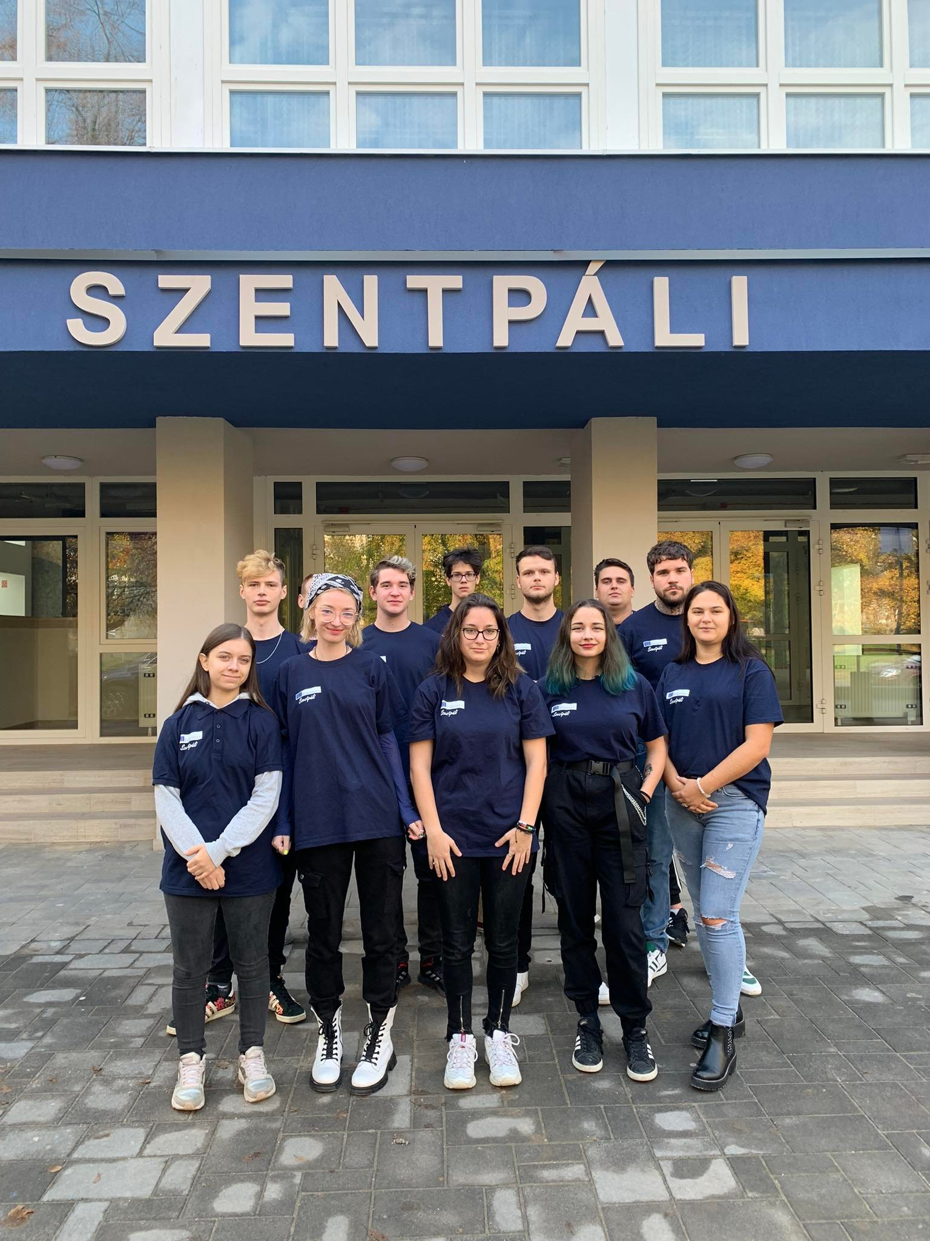
Partner School Connection:
2022 Erasmus+ FOOD-TOUR (Germany – Hungary)
Hungary: Vocational Training Center of Miskolc, István Szentpáli Technical and Vocational School of Catering and Trade
Germany: Berufsschule III. Aschaffenburg

Slide 3
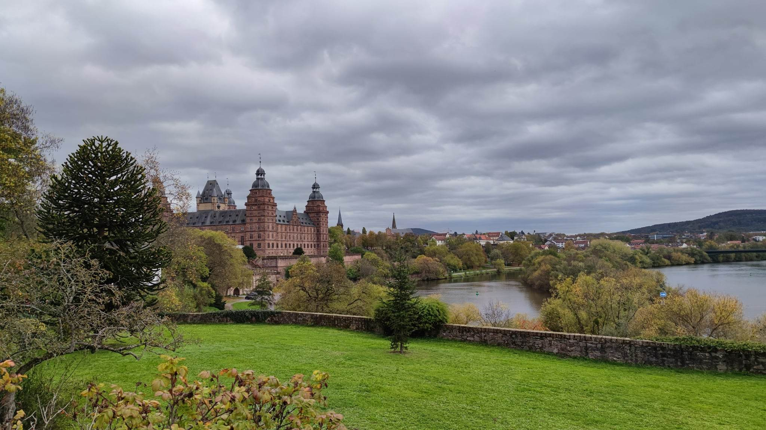
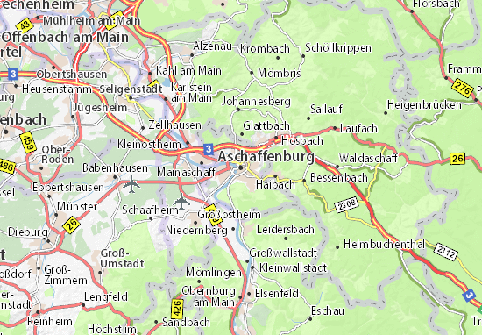
Germany - Aschaffenburg Geography
The town is located on both sides of the Main in North-West Bavaria
Aschaffenburg has the population of 71.381
It comprises 10 Districts
Main sights:
Johannisburg is the late-Gothic castle was destroyed in 1552, but it was replaced in between 1605-14. The castle was rebuilt to be used as a museum.
Pompejanum: It stands on the coast of the Main. Built by King Louis I of Bavaria between 1842-1849, it is a copy of a building excavated in Pompeii
The city hall is located on the base of the former city wall

Slide 4
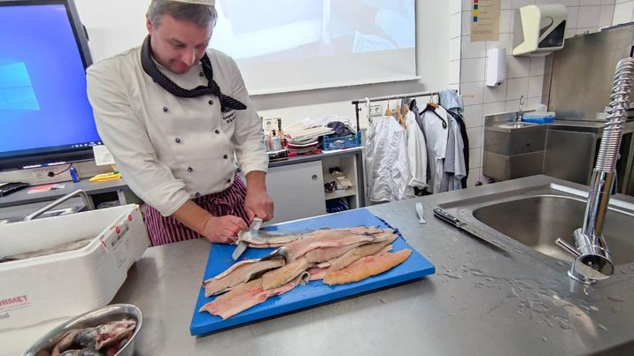
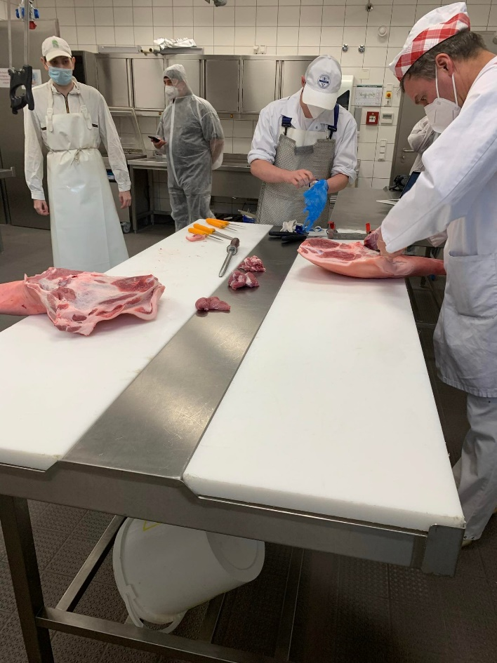
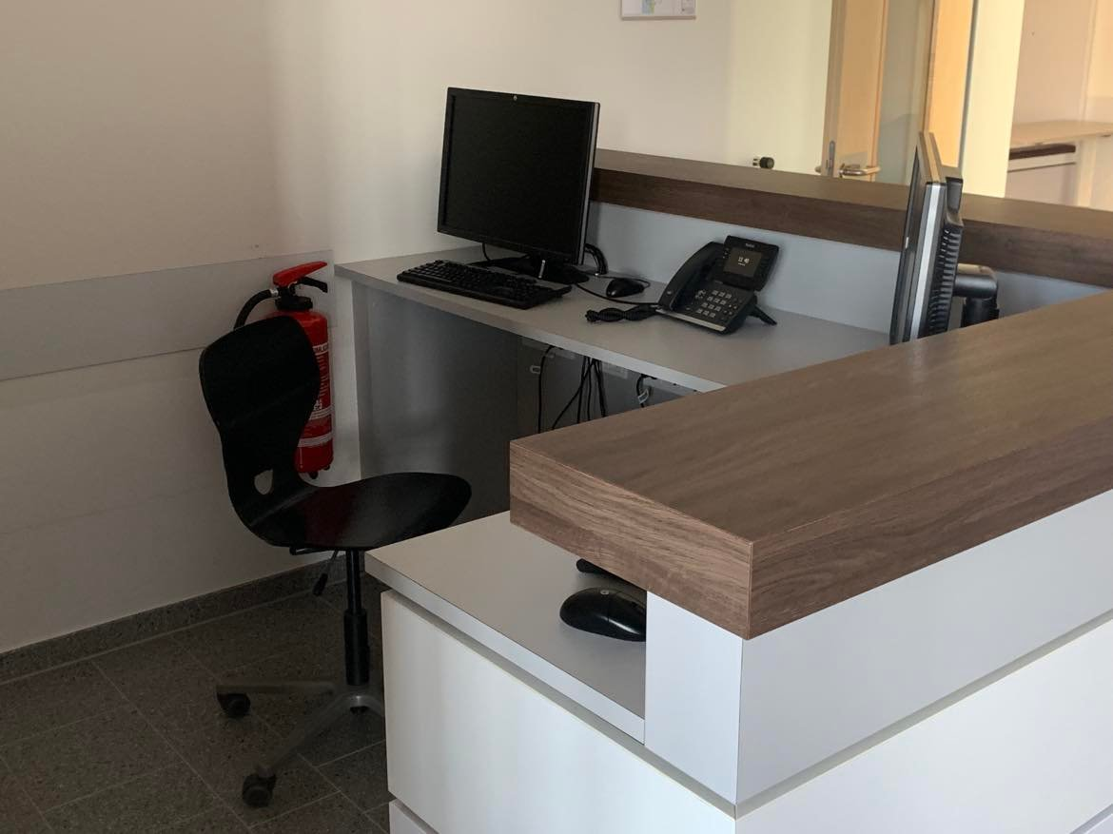
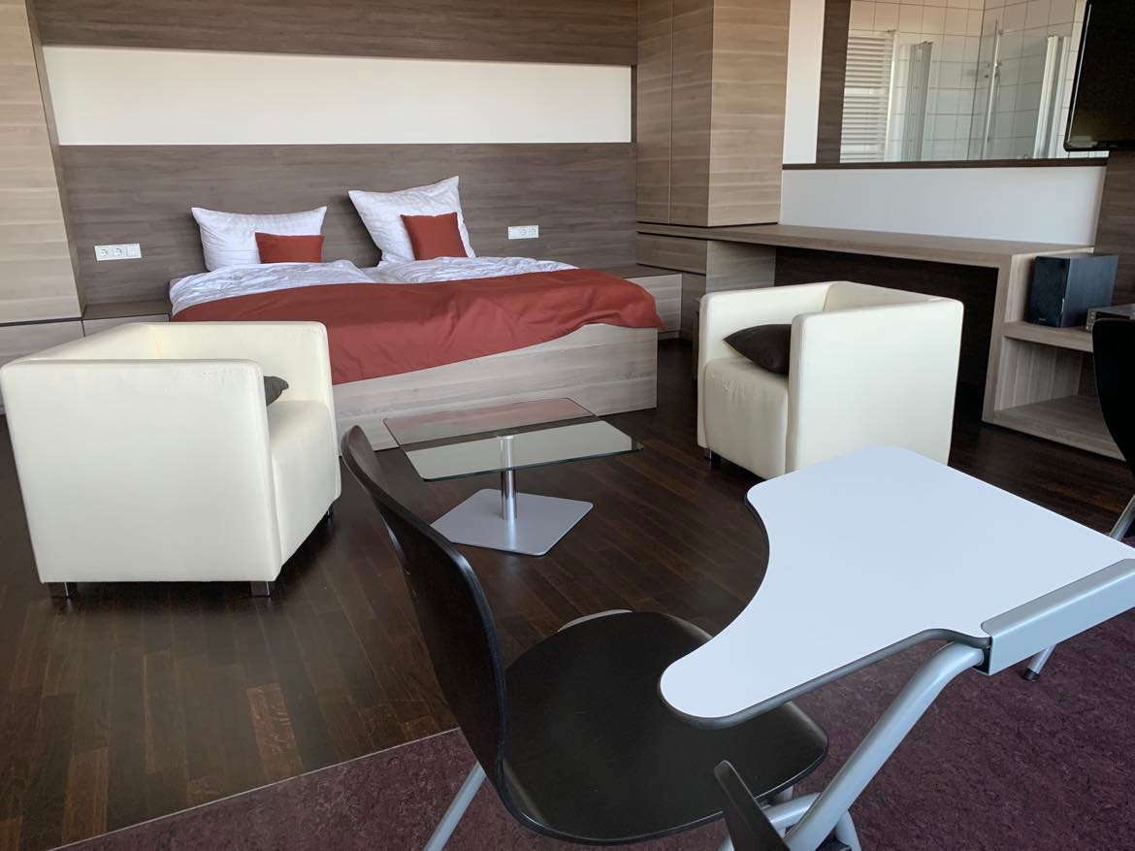
Partner school in Aschaffenburg Beruffschule III:
Expert in hotel and catering industry
Chef
Assistant chef
Baker
Butcher
Sales assistant in butcher’s shop
The practice area is located in the school
The school building is under construction since 2019.
For practice lessons the raw materials are obtained from local producers
Students have 4 days of practice and one day of theory in school

Slide 5
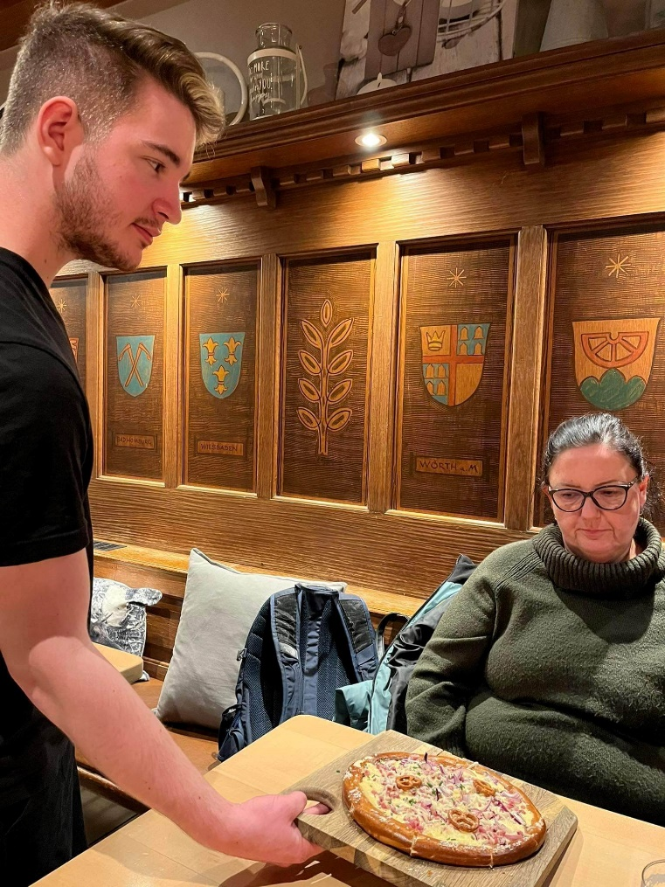
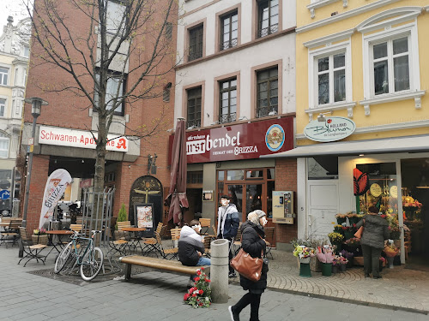
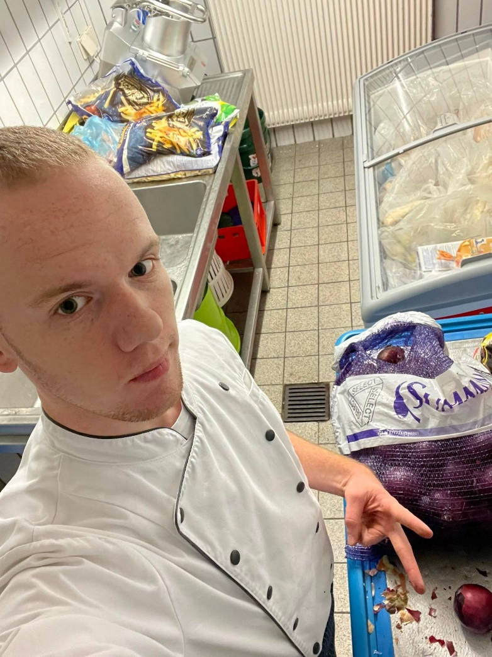
Our workpractice at Zeller Jennifer Wurstbendel Wirtshaus:
Máté Dominik Schadt worked as a waiter - took orders and recommended dishes and drinks to guests
Adam Böszörményi worked as a chef - prepared special dishes such as Brizza

Slide 6
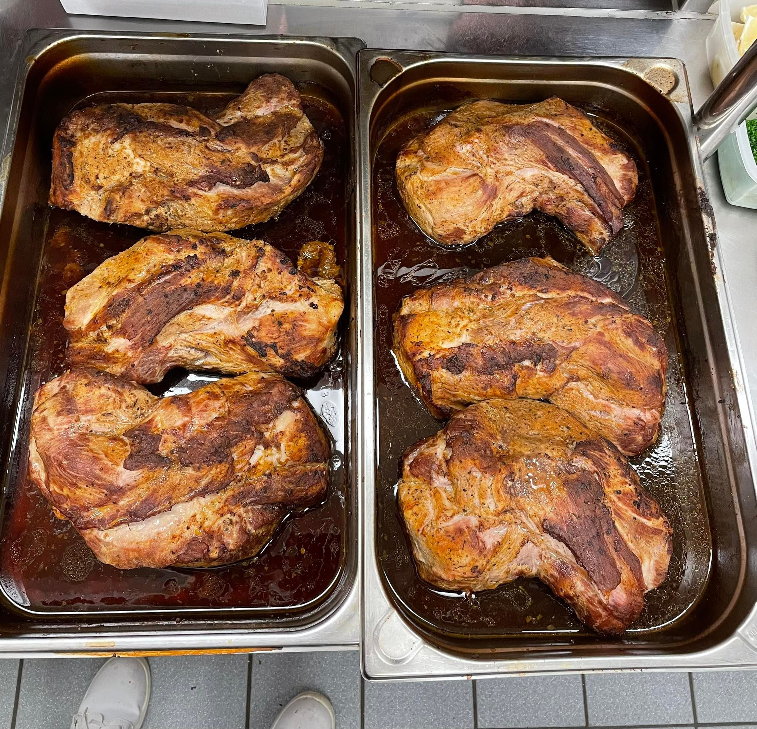
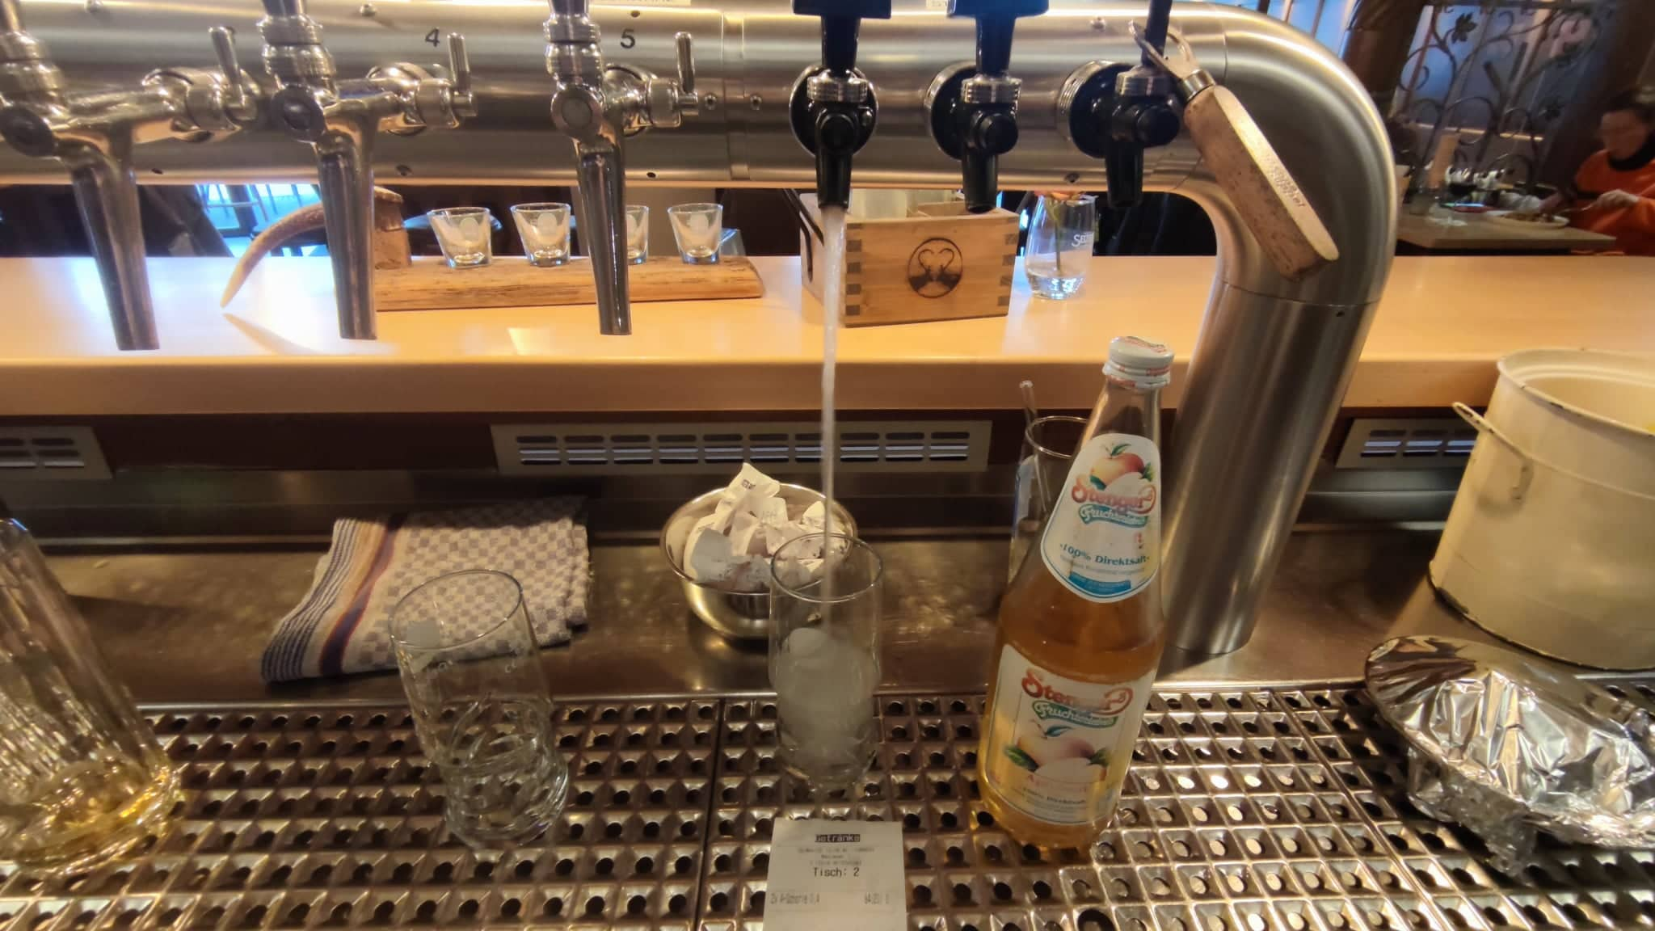
We learnt new things related to our profession such as preparing the house speciality and bartendering

Slide 7
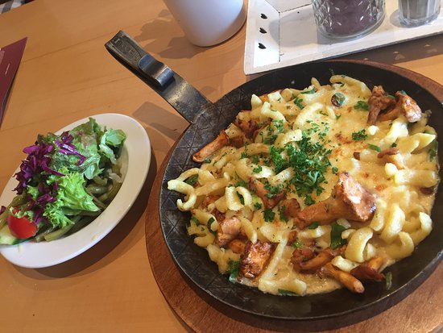
We made progress & did some tasks individually

Slide 8
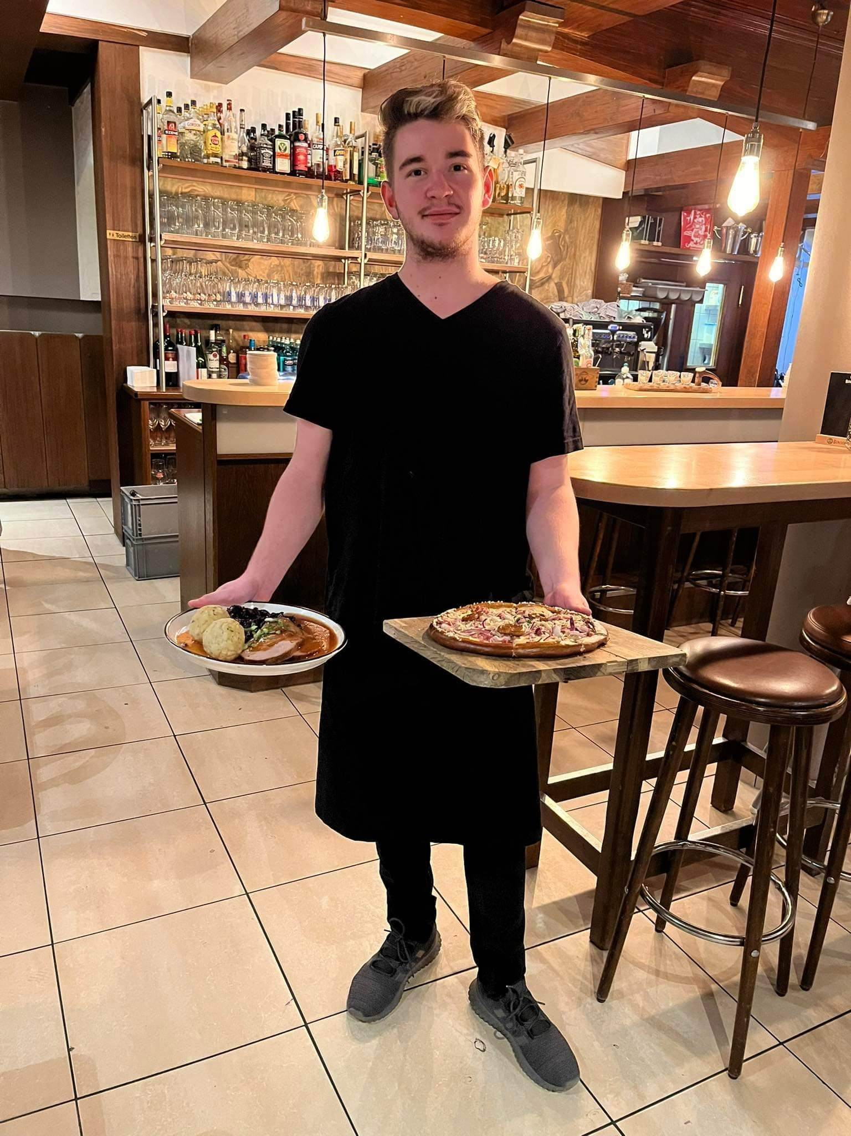
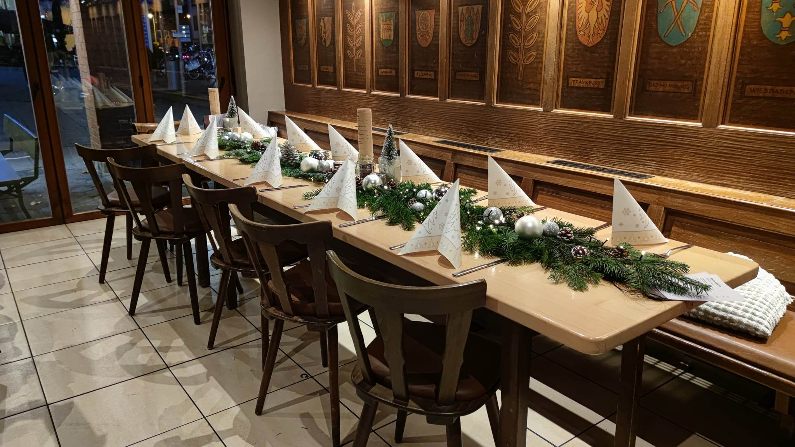
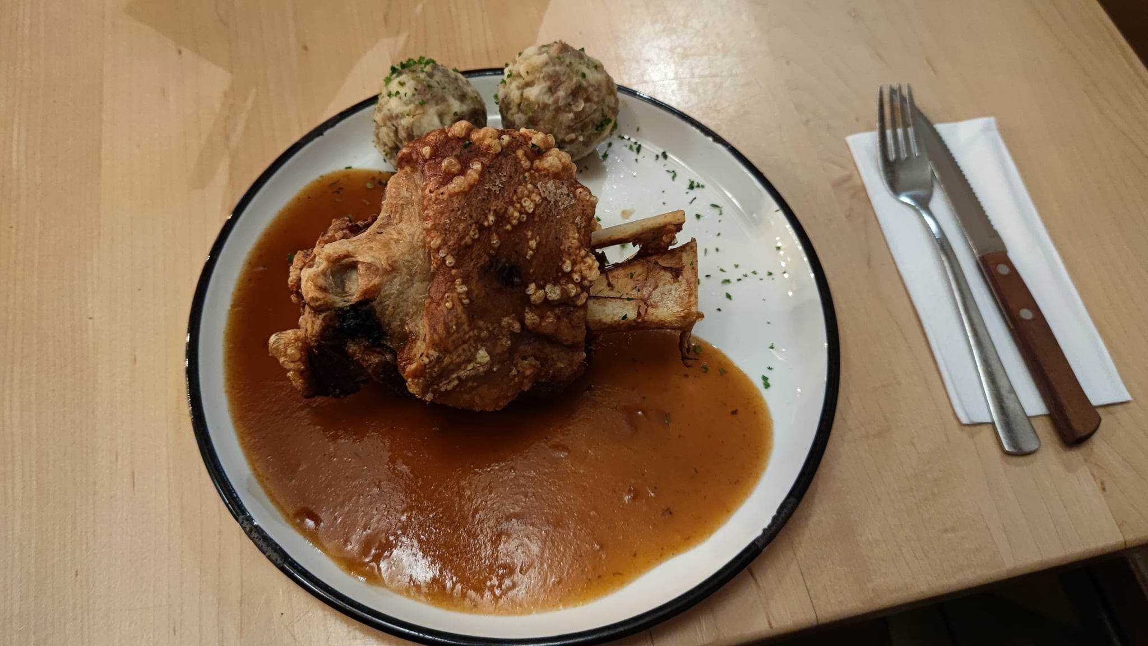
Serving a 12 guest table:
Adam’s tasks before the event:
Preparation and cutting of raw materials
Preparation of meat dishes
Preparation of salads and decoration of dishes
The chefs recieved the orders, and started cooking the meals together with Adam
Dominik’s tasks when the guests arrived:
Setting the table
Decorating the table
Taking and serving drinks orders
Assisting with food servicing

Slide 9
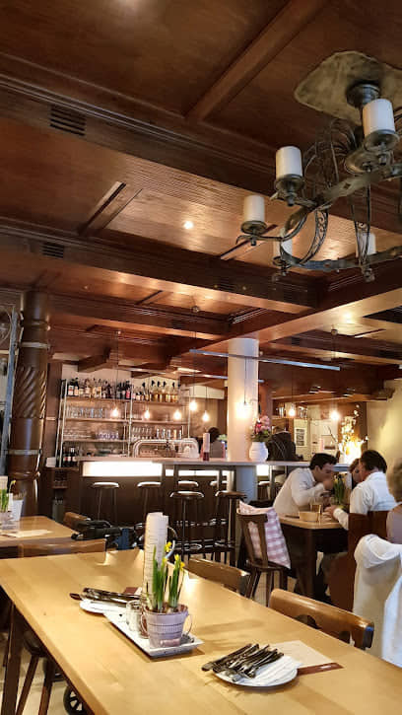
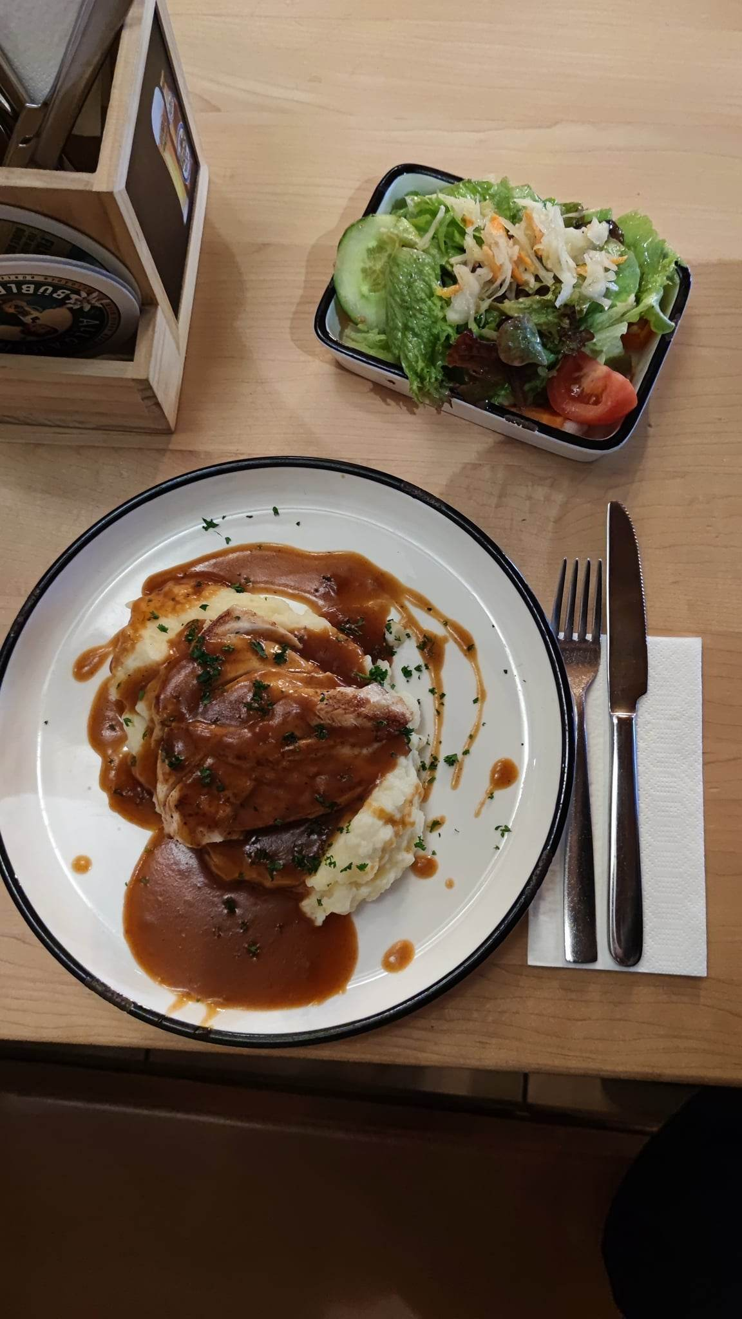
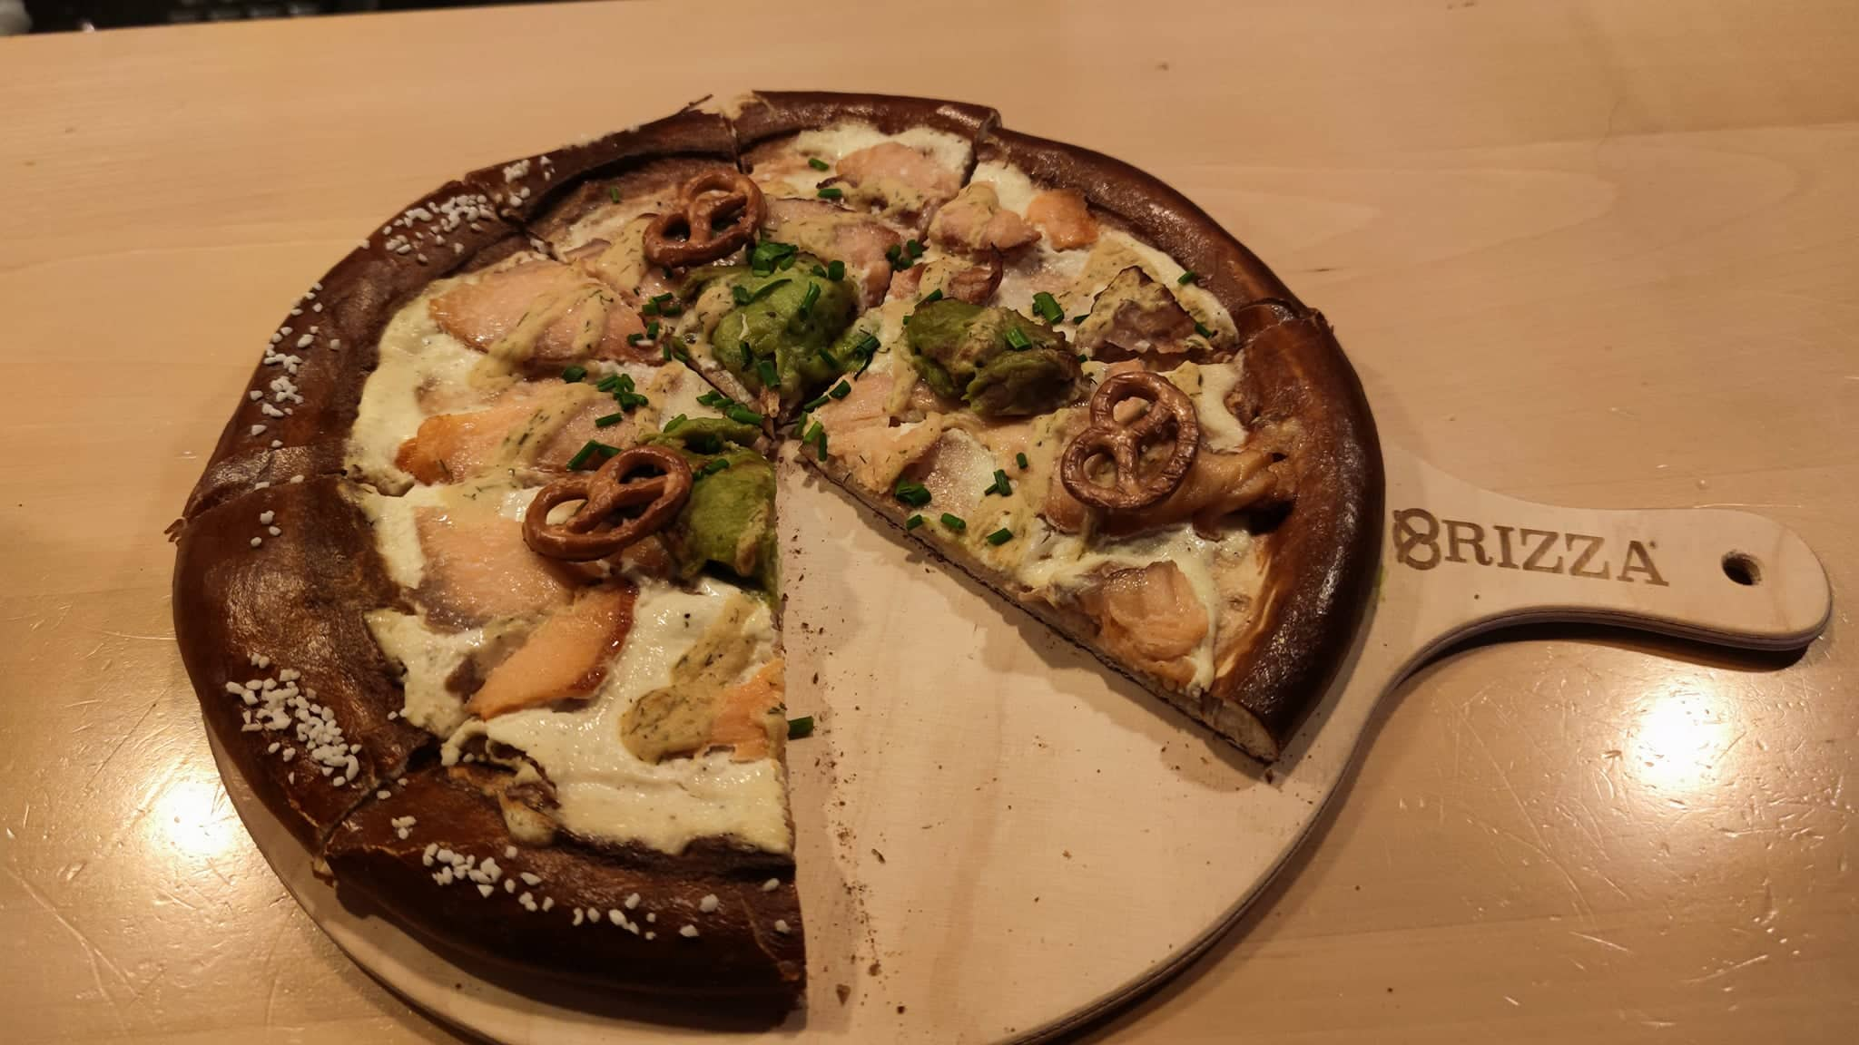
Bar and Restaurant
Zeller Jennifer Wurstbendel Wirtshaus

Slide 10
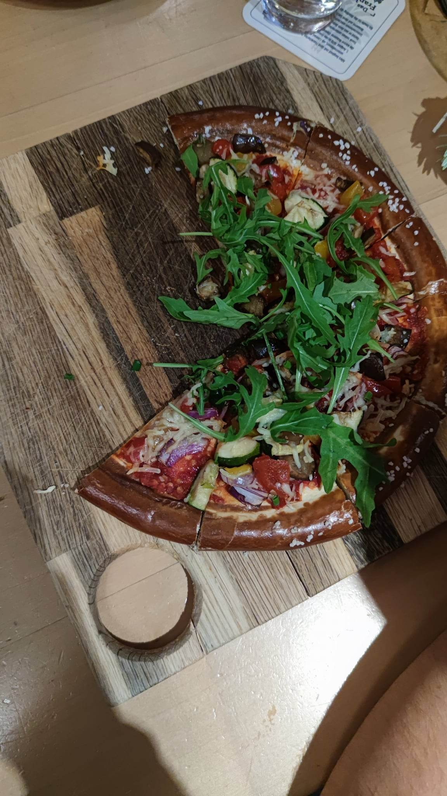
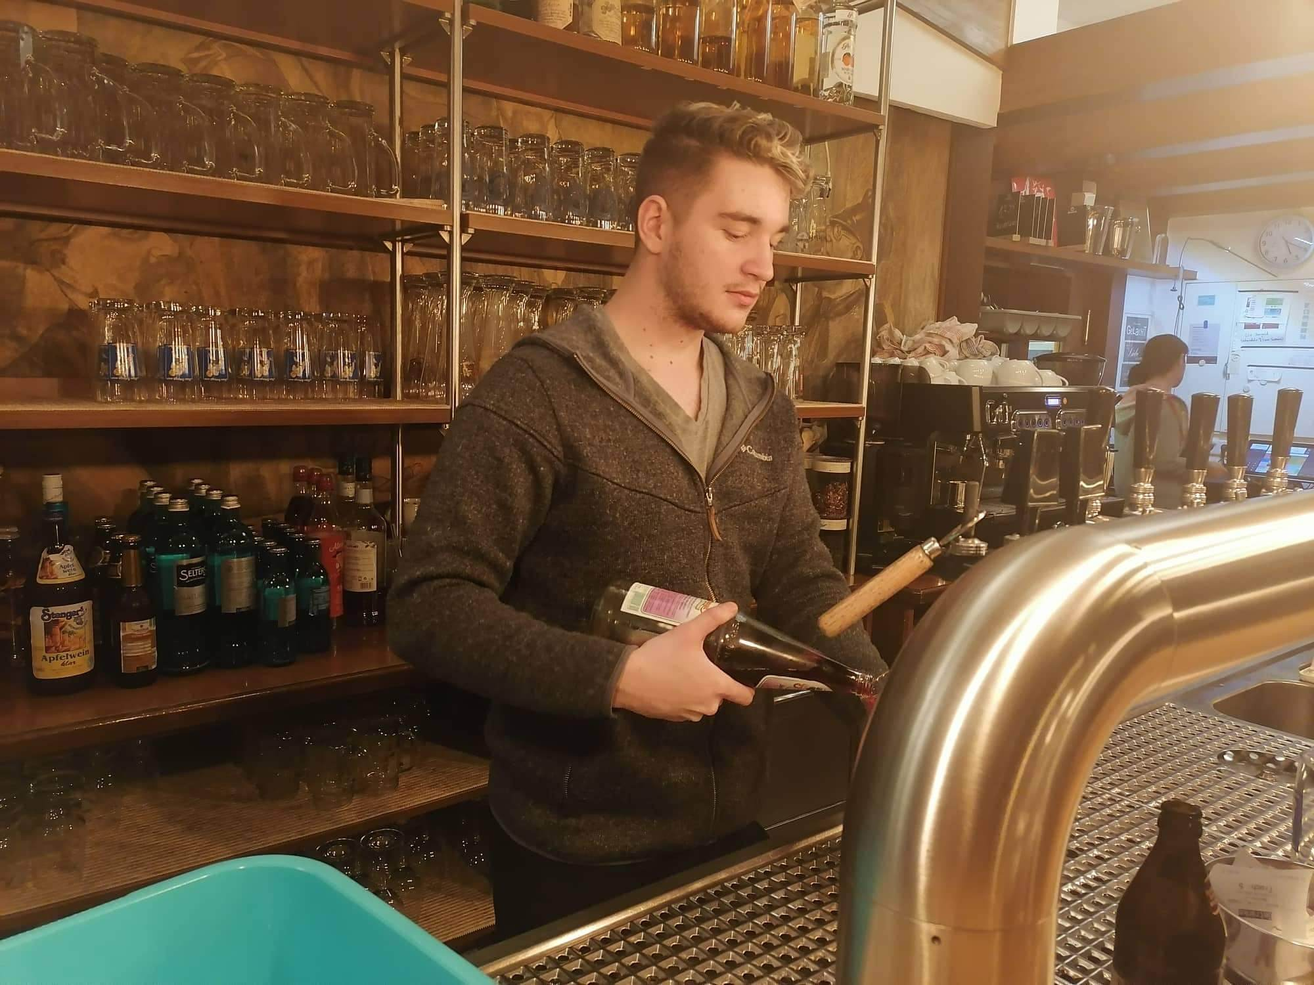
Dominik’s and Adam’s job
Daily Routines:
Dominik:
Restocking the drinks used in the bar
Changing the beer barrels
Taking orders from customers
Making our specialty drinks
Adam:
Restocking the fridges
Slicing, and peeling vegetables
Baking Brizza
Helping the head chef making vegetarian meals

Slide 11
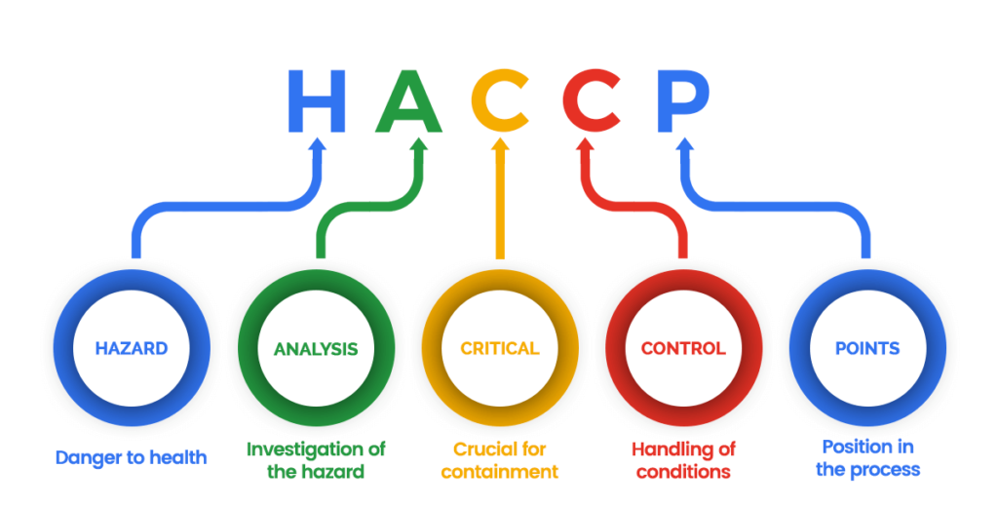
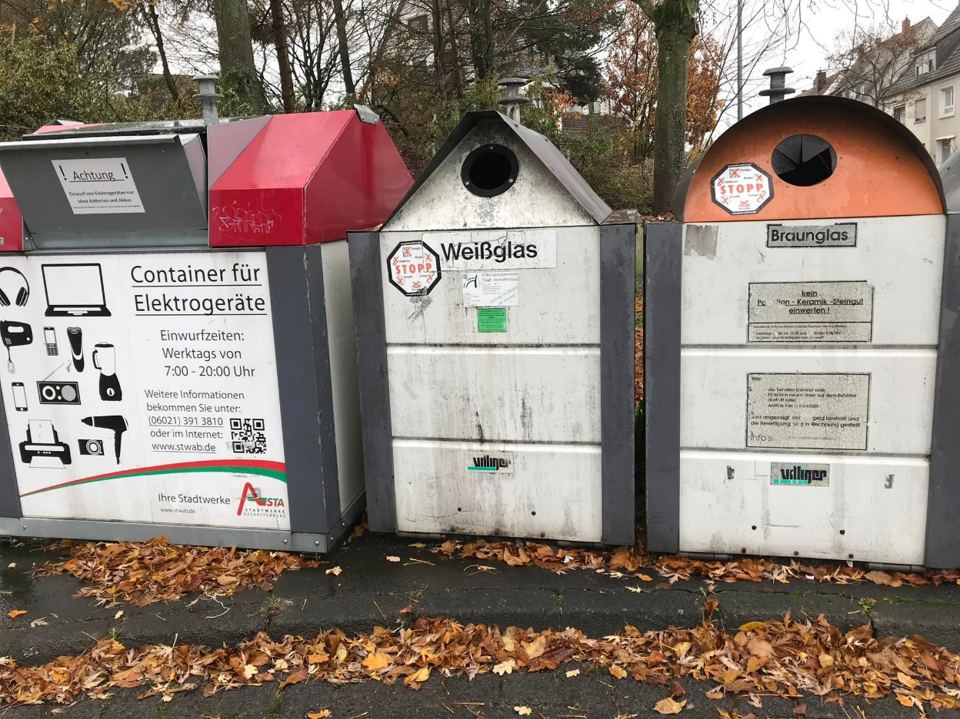
Environmental awareness and HACCP
Only chemical-free cleaning products were used
This place uses only easily degradable, recyclable packaging materials
HACCP strict compliance
They pay attention to the FIFO principle
The clear path principle (not taking in goods where the trash and swill is taken out)
Alfie`s Bar

Slide 12
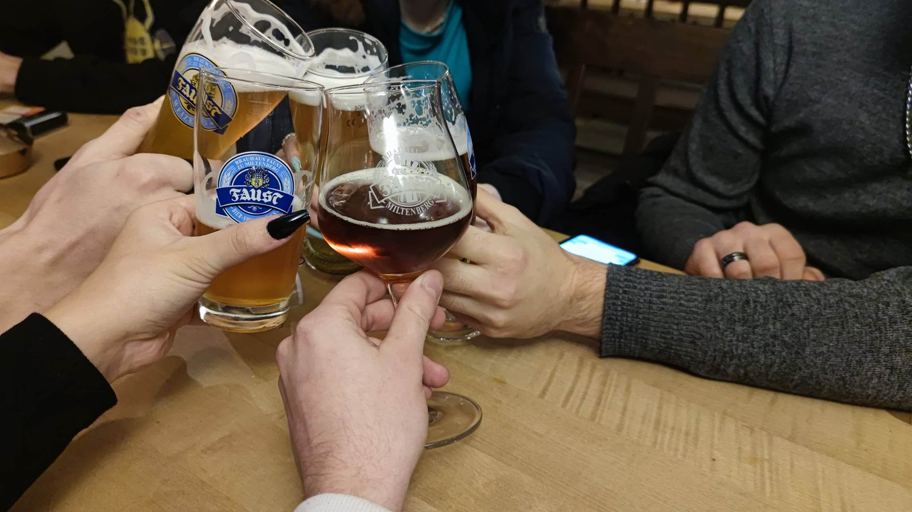
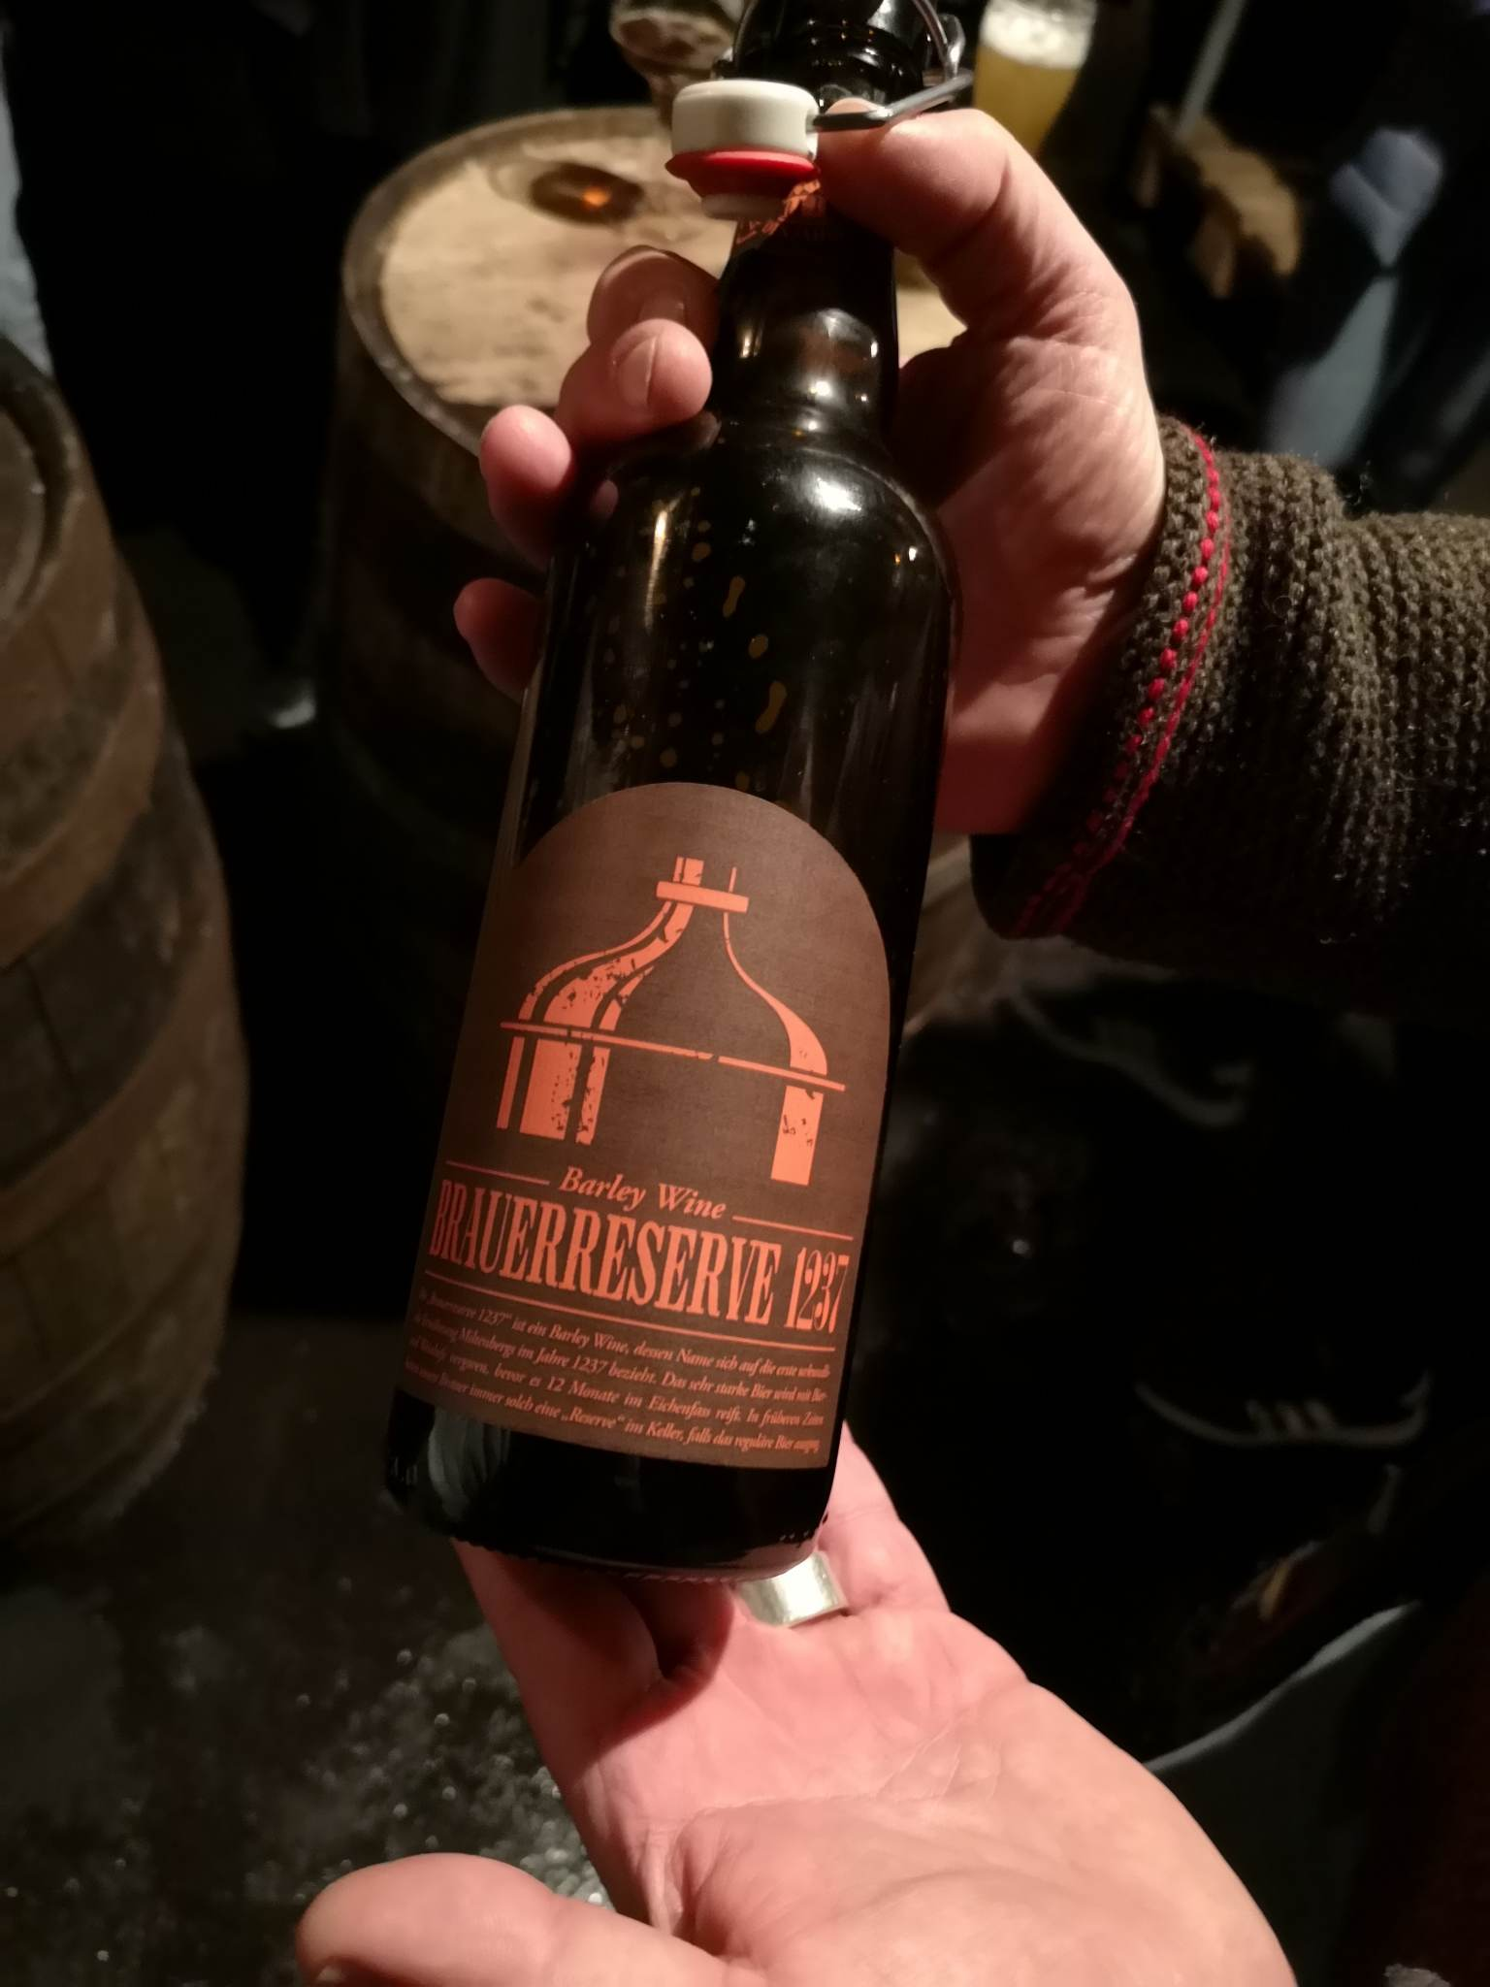
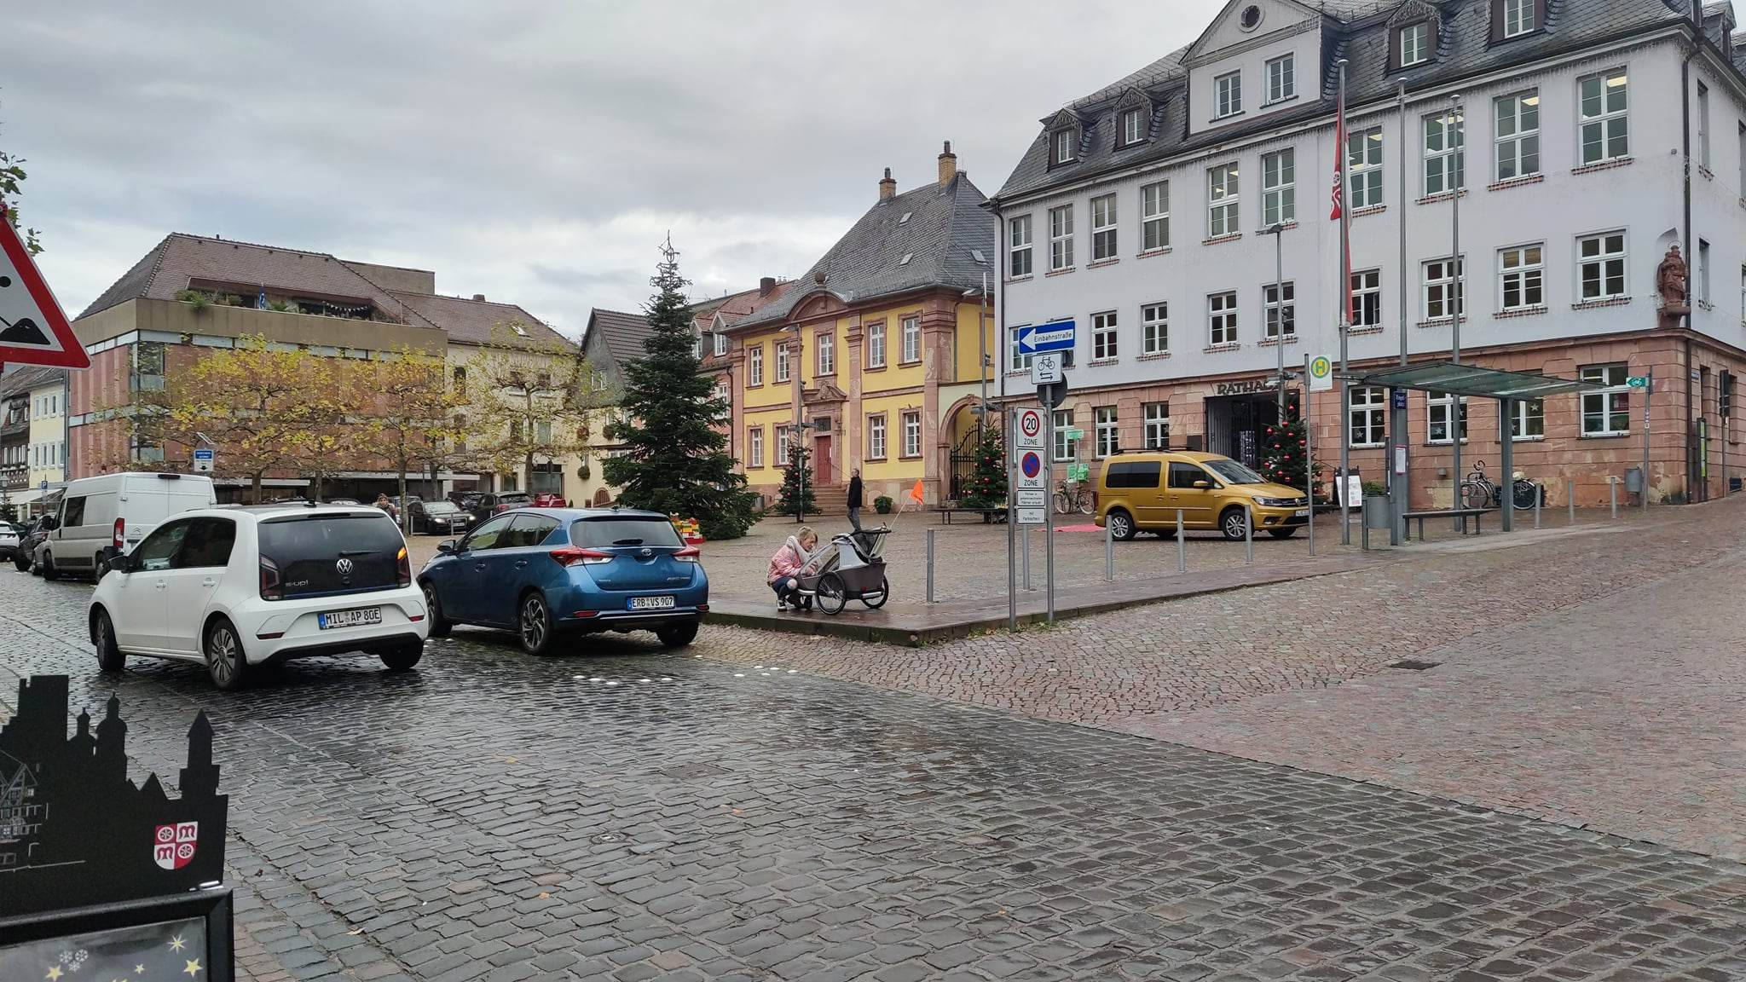
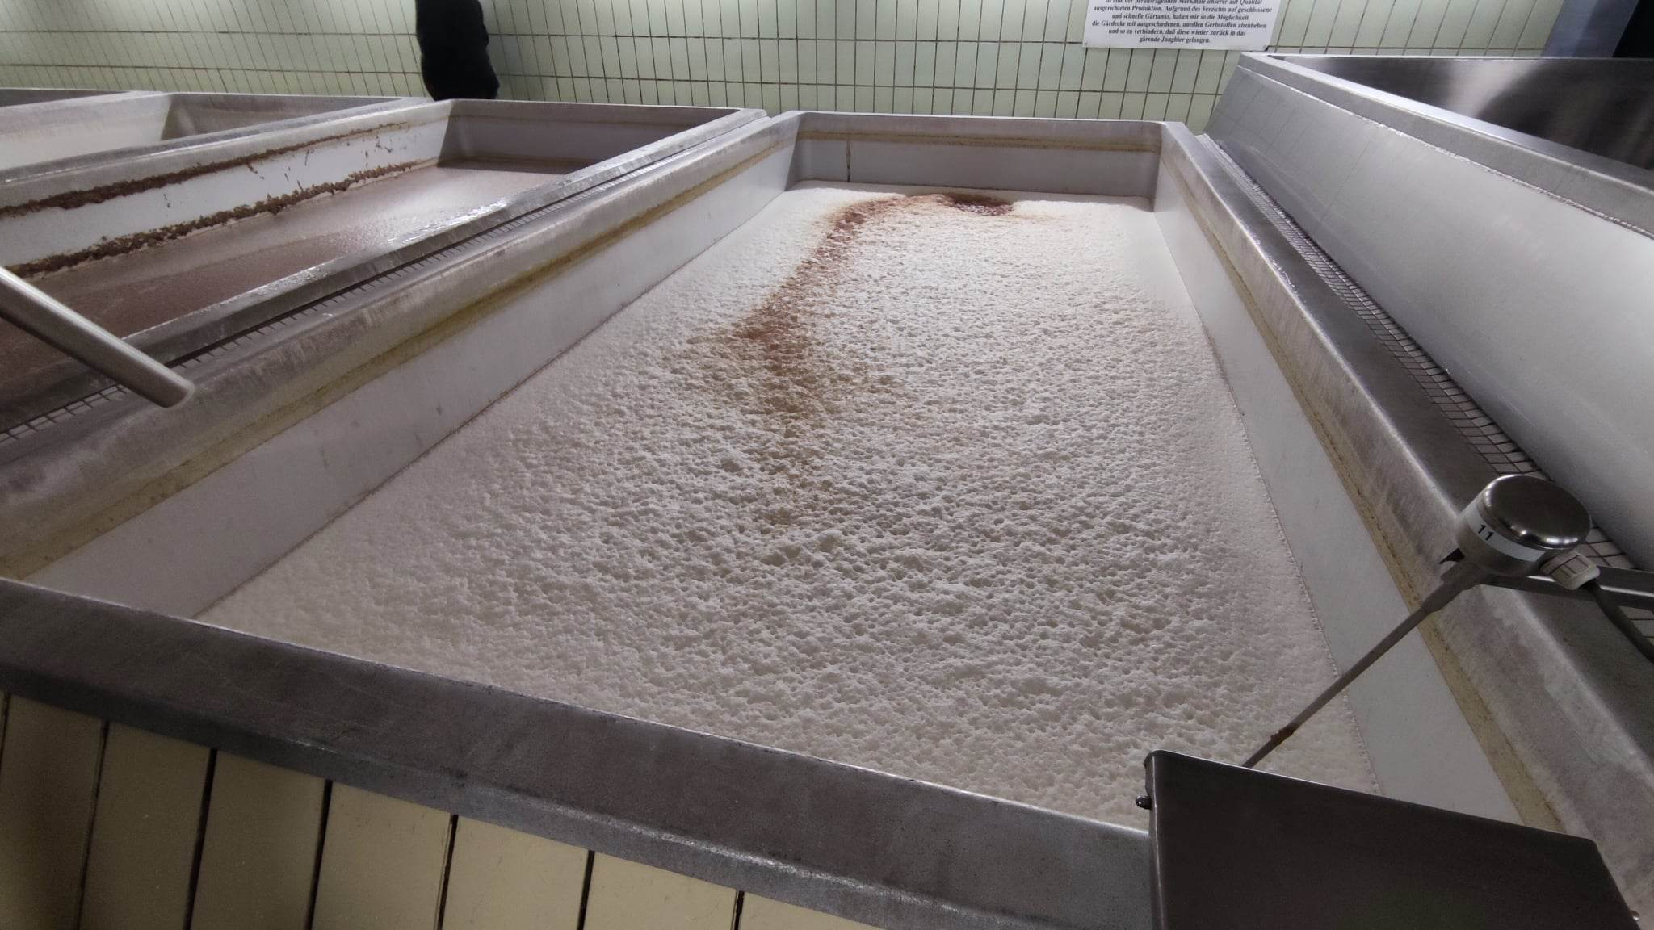
Miltenberg/Faust Brewery
Bottom-top fermentation beers
Brewing different alcoholic and alcohol-free beers
Appearance at many world-famous events
Presentation of a home brewery, red wine yeast was used in the preparation of some beers

Slide 13
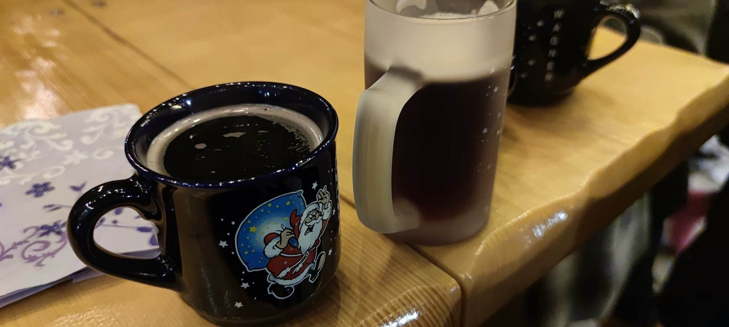
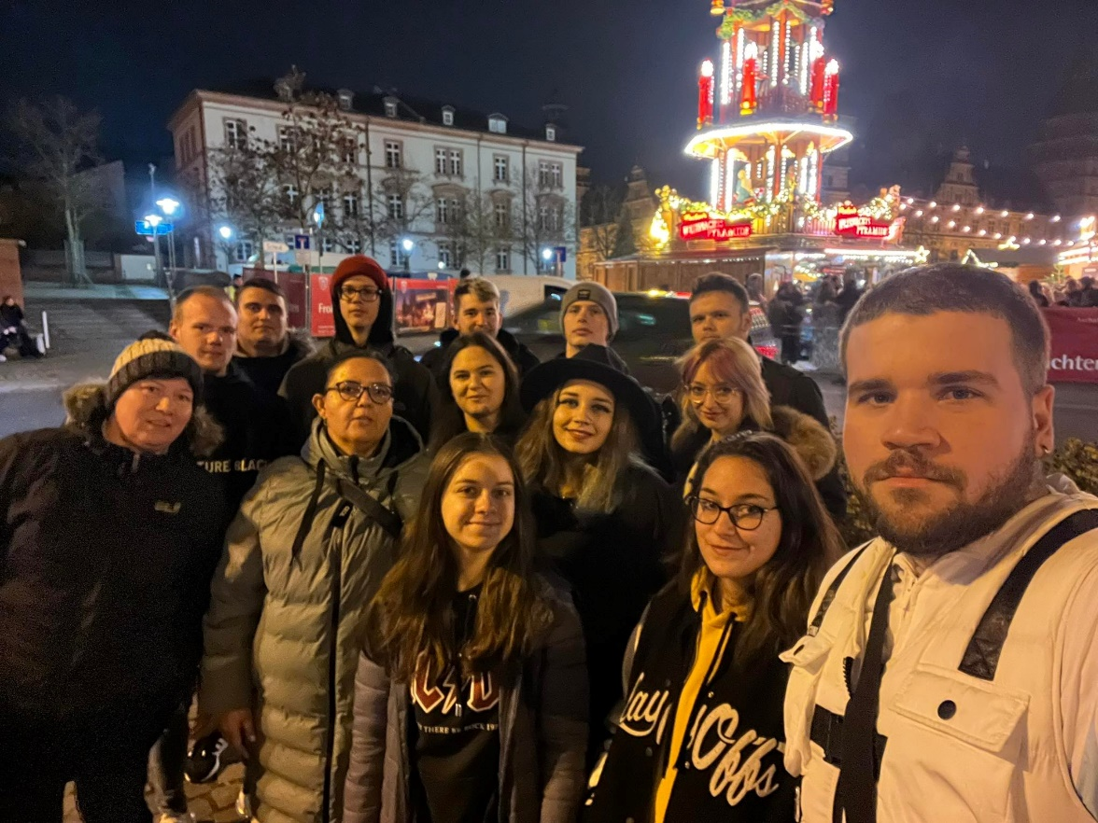
Christmas market
The fair was held in the main square of Aschaffenburg, with many fair vendors
Handmade German Christmas specialties (ingredients from local producers, such as mulled wine) were sold

Slide 14
SPECIAL THANKS
To the European Union
To the Vocational Training Center of Miskolc, István Szentpáli Technical and Vocational School of Catering and Trade
To Zeller Jennifer Wurstbendel Wirtshaus and my colleges: Ekici, Kim, Magalena, Jasmin and Alex
To my teachers and mentors
Thank you for your attention
A projektet az Európai Unió támogatta. A kiadványban (közleményben) megjelentek nem szükségszerűen tükrözik az Európai Bizottság nézeteit.

