Slide 1
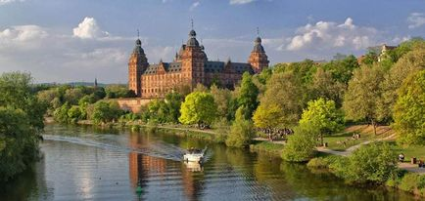
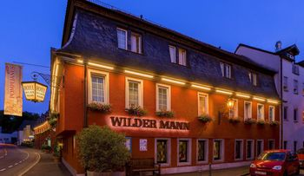
ERASMUS+ FOOD-TOUR: Fostering Transferable Skills 06.11.2022.-29.11.2022.
Erasmus+ 2020-1-HU01-KA102-078492 FOOD-TOUR: Fostering Transferable Skills
Made by: Kamilla Mudrova
Norbert Dmitrij Sztecenkó
Placement: Schönbusch Kleine
A projektet az Európai Unió támogatta. A kiadványban (közleményben) megjelentek nem szükségszerűen tükrözik az Európai Bizottság nézeteit.

Slide 2
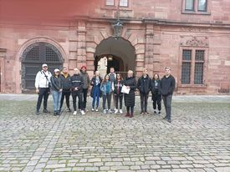
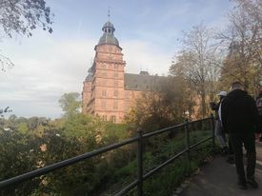
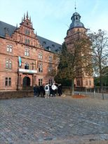
Germany - Aschaffenburg Geography
South-Western, 41 km away from Frankfurt am Main
The population is about 71k people
Aschaffenburg has 10 districts
Compared to the size of the city, it has large shopping centers
Other large cities: Frankfurt, Würzburg

Slide 3
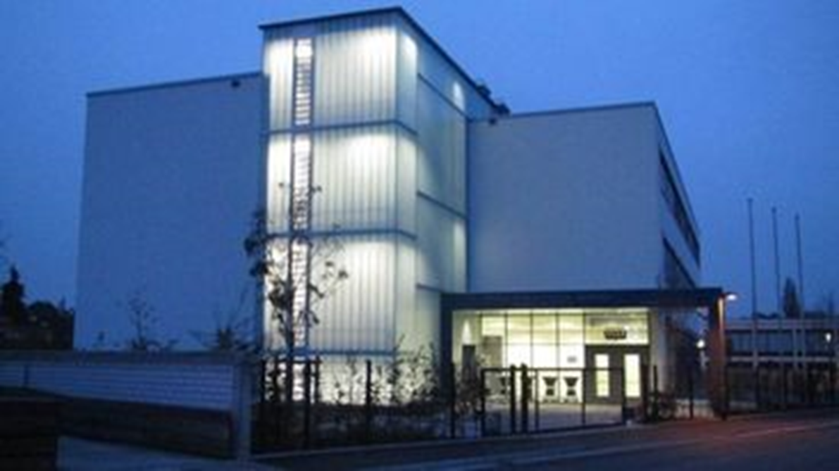
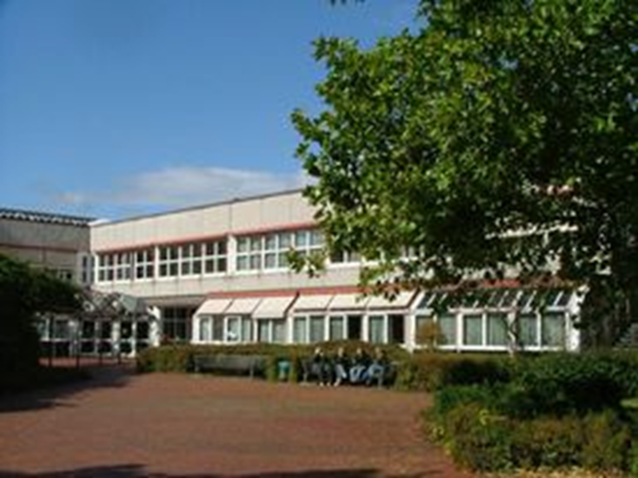
Partner school in Aschaffenburg: Berufsschulle lll
Internationally recognised qualifications
High quality teaching and learning environment
Flexible learning opportunities
Voctional training for: chefs, assistant chefs, butchers, pastry-chefs, bakers, experts in hotel and catering industry

Slide 4
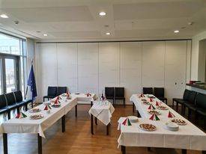
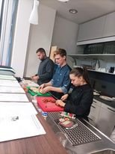
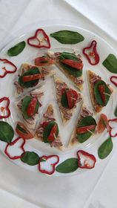
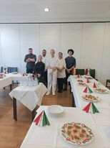
Hungarian Themed Event with
Finger-food
Partner meeting between the Vocational Training Center of Miskolc, István Szentpáli Technical and Vocational School of Catering and Trade& Berufsschule III. Aschaffenburg

Slide 5
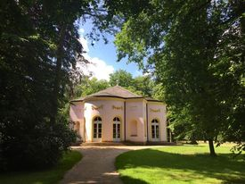
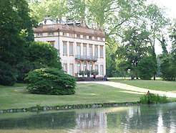
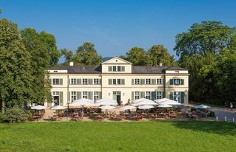
Kulinarischer Schönbusch Kleine Bistro Restaurant
The Schönbusch Landscape Park is one of the most beautiful parks in Bavaria.
This place offers you something special in nature and culinary terms as well.

Slide 6
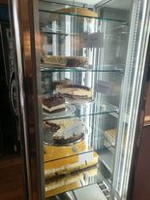
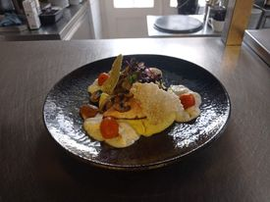
We got to know the restaurant’s kitchen
How the kitchen functions
Where the ingredients are from
What kind of enviromental friendly chemicals they use

Slide 7
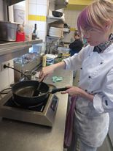
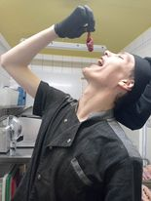
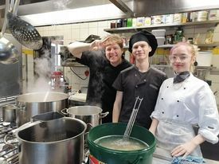
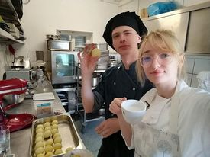
Our workplace: Schönbusch Kleine
Kamilla’s and Dmitrij’s work experience

Slide 8
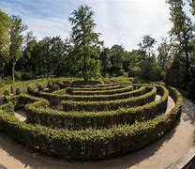
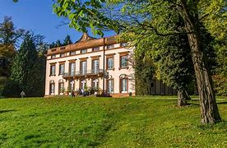
Offerings:
Two rooms for conferences
Large park, for roaming, relaxing and walking dogs
Large lake by the restaurant, with a great view
Pavilon next to the restaurant
Free Wi-fi
Playground for the kids
A labirynth with an amazing atmosphere
Unique vibe inside
Two parkinglots
Biergarten Schönbusch is a beergarden, with several kinds of beers

Slide 9
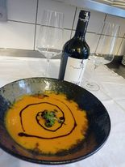
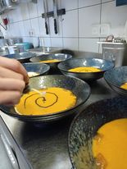
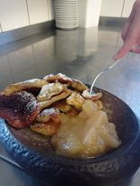
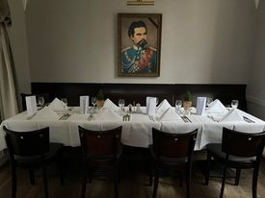
Game themed lunch
Dmitrij: prepared the mixed salad and the pumpkin cream soup.
Kamilla: prepared the panna cotta with raspberry marrow.

Slide 10
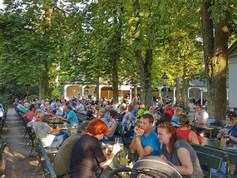
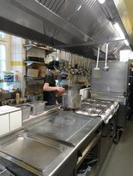
Biergarten Schönbusch
Schönbusch Kleine kitchen

Slide 11
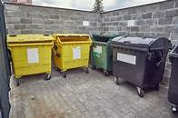
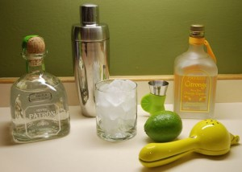
Environmental awareness
Enviromental friendly chemicals:
Composable leftovers
Plastic seperation
Paper seperation
Vinegar
Citric acid
Baking soda

Slide 12
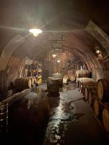
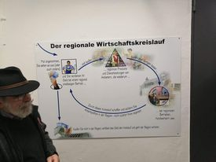
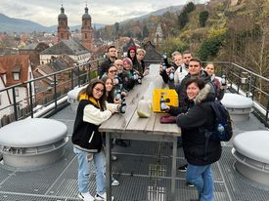
Miltenberg: Faust brewery
Plant visit
They make different types of beer: Pils Feinherb, Bayrisch Hell, Export Urhell, Radler, Radler alkoholfrei, Doppelbock Dunkel és Festbier.
Tried traditional food: Pretzel, White sausage with sweet-mustard

Slide 13
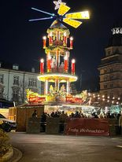
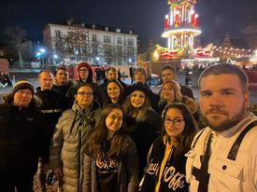
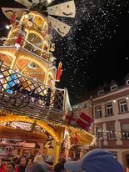
Christmas Market visit
Main square of the Aschaffenburg
Handmade German christmas specialities
Mulled wine, baked apples, punch, pretzels, apple and pumkin strudels, fried sausages, various bonbons, and different kinds of cheese

Slide 14
Achtung!
Thank you so much!
We appreciate taking part in the Erasmus+ Food-Tour very much because of this development opportunity. Special thanks for my colleagues and mentors for expanding our professional and foreign language knowledge
A projektet az Európai Unió támogatta. A kiadványban (közleményben) megjelentek nem szükségszerűen tükrözik az Európai Bizottság nézeteit.

