Slide 1



ERASMUS+ FOOD-TOUR Fostering Transferable Skills
Aschaffenburg; Germany
2022.11.6.-2022.11.29.
Placement: Confiserie Fischer
Made by:
Lakatos Jázmin Mária
Mészáros Veronika
A projektet az Európai Unió támogatta. A kiadványban (közleményben) megjelentek nem szükségszerűen tükrözik az Európai Bizottság nézeteit.

Slide 2
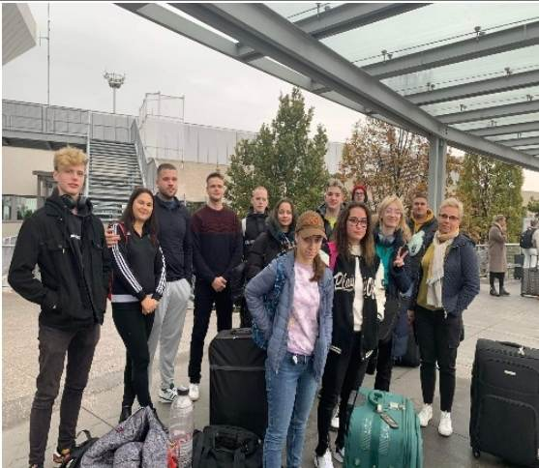
Partner School Connection:
2022 Erasmus+ FOOD-TOUR
(Aschaffenburg – Miskolc)
Germany: Beruffschule III.
Hungary: Vocational Training Center of Miskolc, István Szentpáli Technical and Vocational School of Catering and Trade

Slide 3
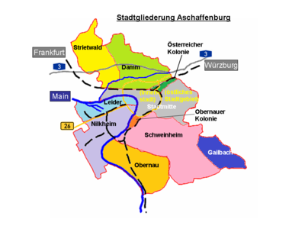
Germany – Aschaffenburg
geography
The town is located on both sides of the Main in north-west Bavaria, bordering to Hesse
The region is also known as "Bavarian Lower Main".
the inhabitants speak neither Bavarian nor East Franconian but rather a local version of Rhine Franconian.
It has 10 districts
It’s population is 71380 people

Slide 4
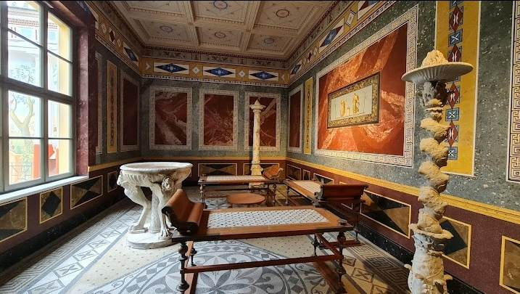
Aschaffenburg’s Attraction’s
Pompejanum: it stands on the coast of the river Main. Built by King Louis I of Balvaria between 1842-49.
Johannisburg: The main sights of Aschaffenburg are the Schloss Johannisburg, built 1605–1614 by Archbishop Johann Schweikhard von Kronberg, which contains a library with a number of incunabula, a collection of engravings and paintings
The city hall is located at the base of the former city wall

Slide 5
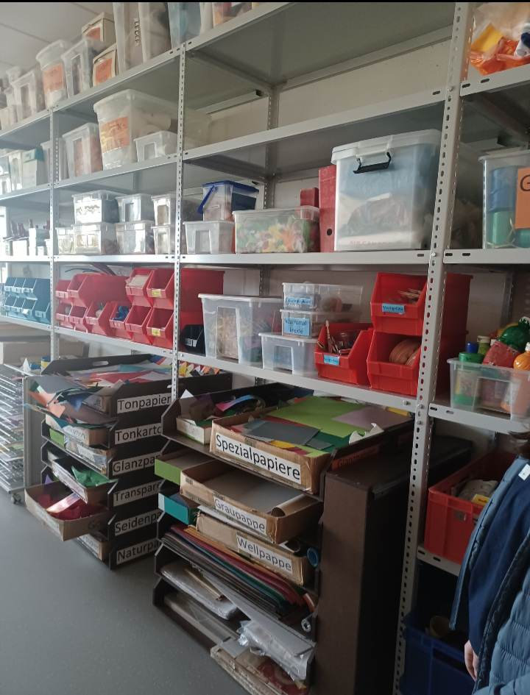
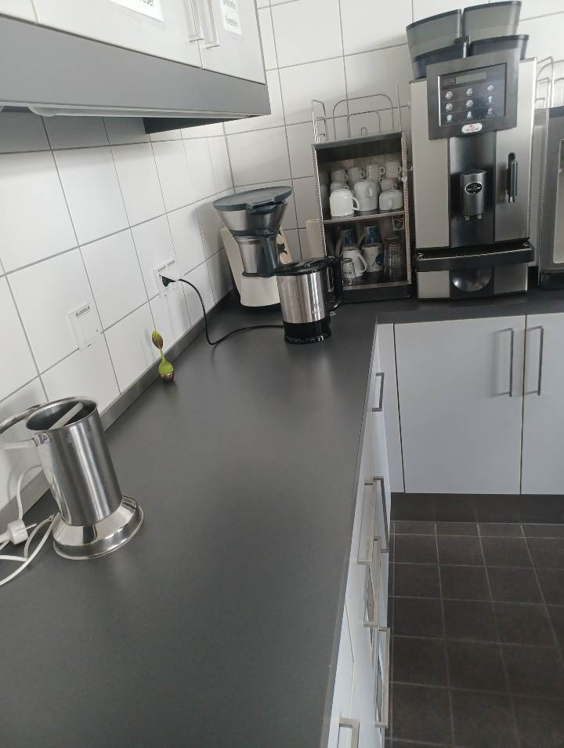
Partner school in aschaffenburg
Berufsschule III
The school consists of 3 parts
Berufschule I.: metalworking trainings
Berufschule II.: electronics trainings
Berufschule III: catering training (seller, hotel professionals, catering, bakery training)

Slide 6
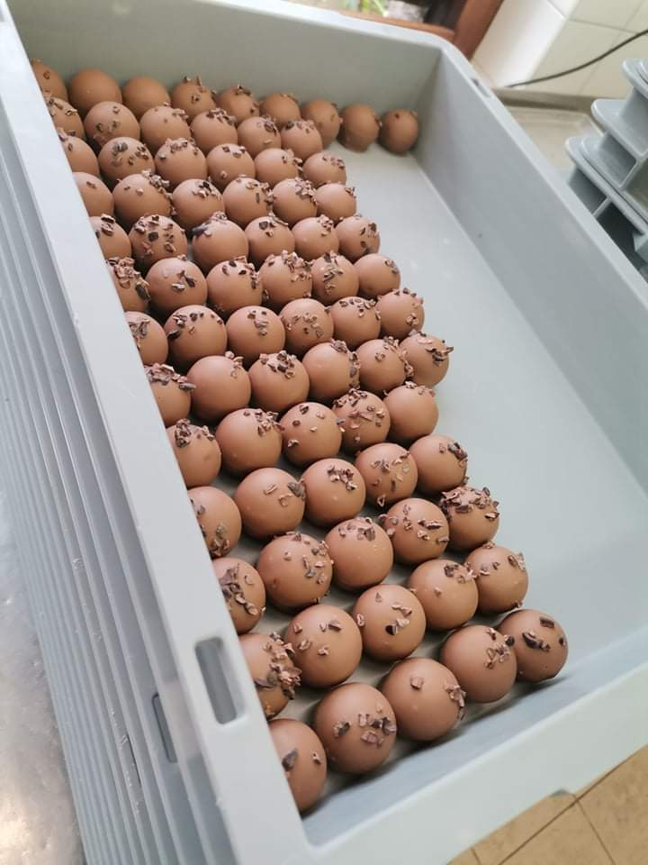
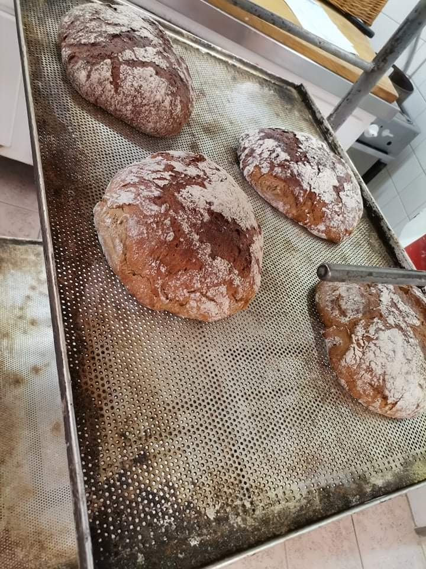
Our Workplace: confiserie fischer
Jürgen Fischer works in truffles, pralines and all areas of confectionery.
It offers: special sweets, fresh chocolates and products made according to traditional and new recipes.

Slide 7
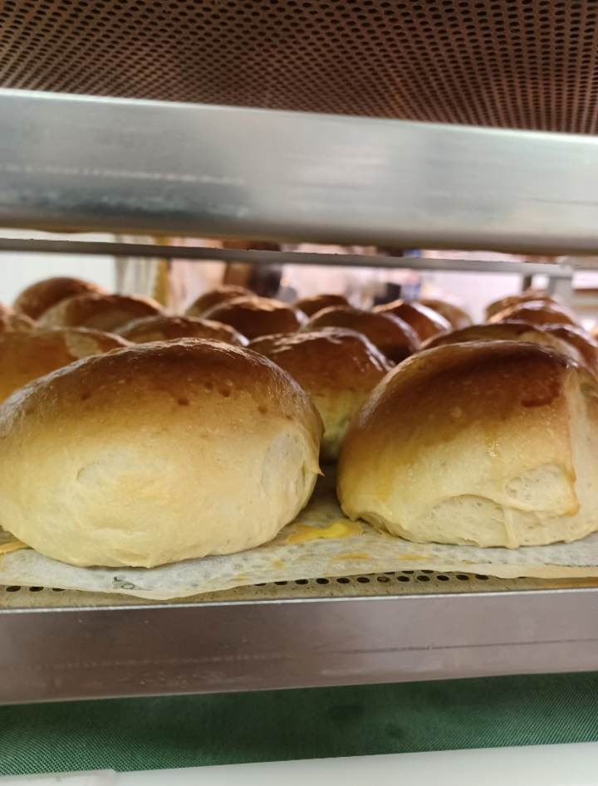
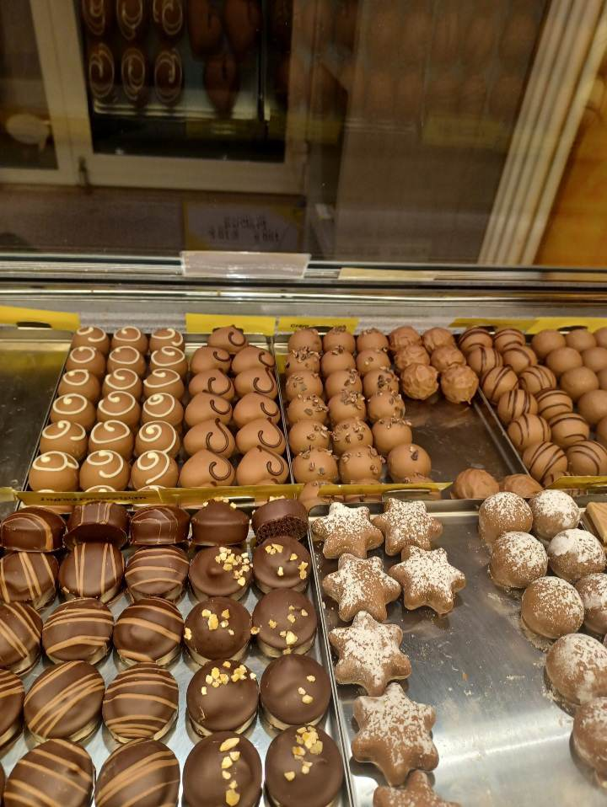
Our placement
Kneading doughs: dated, puff pastry
Making breads, buns, pretzels, Shaping
Preparation of ganache: chocolate, fruit puree, champagne, nougat, pálinka, cocoa beans

Slide 8
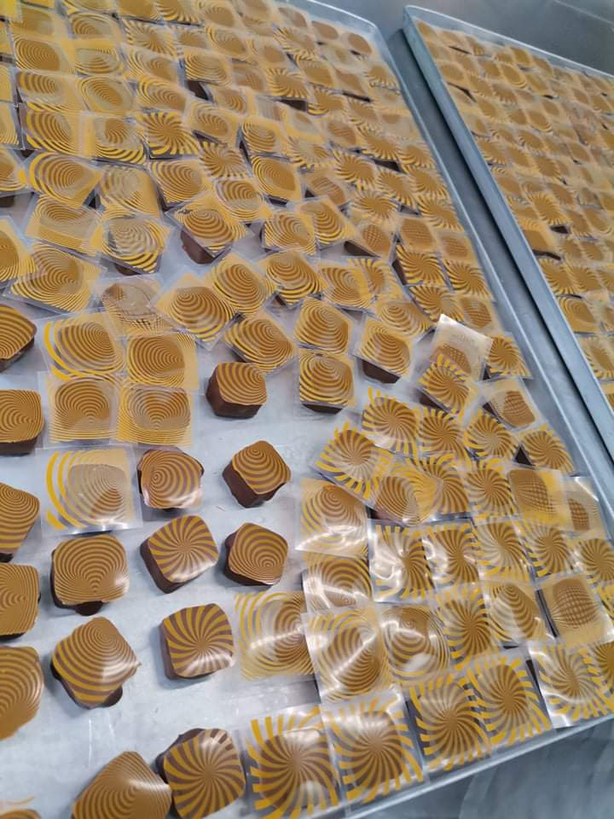
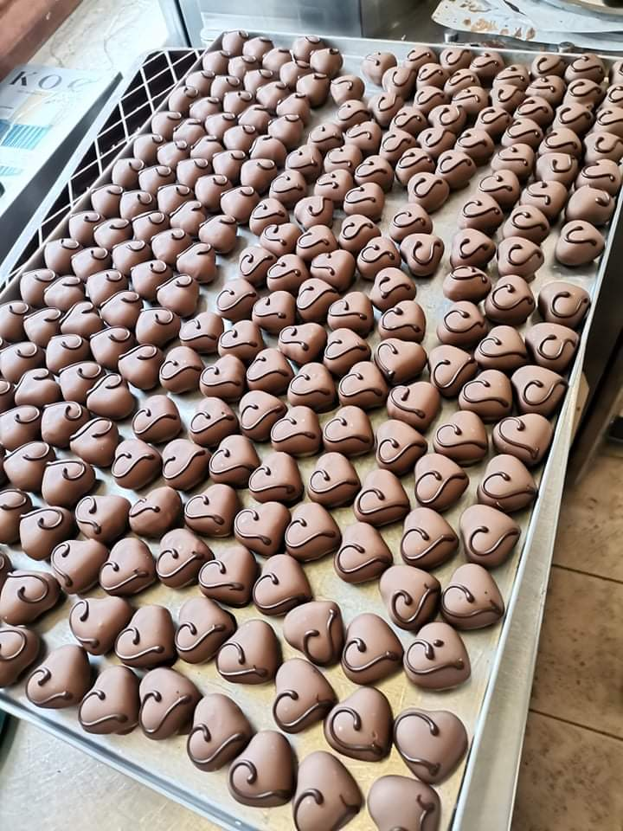
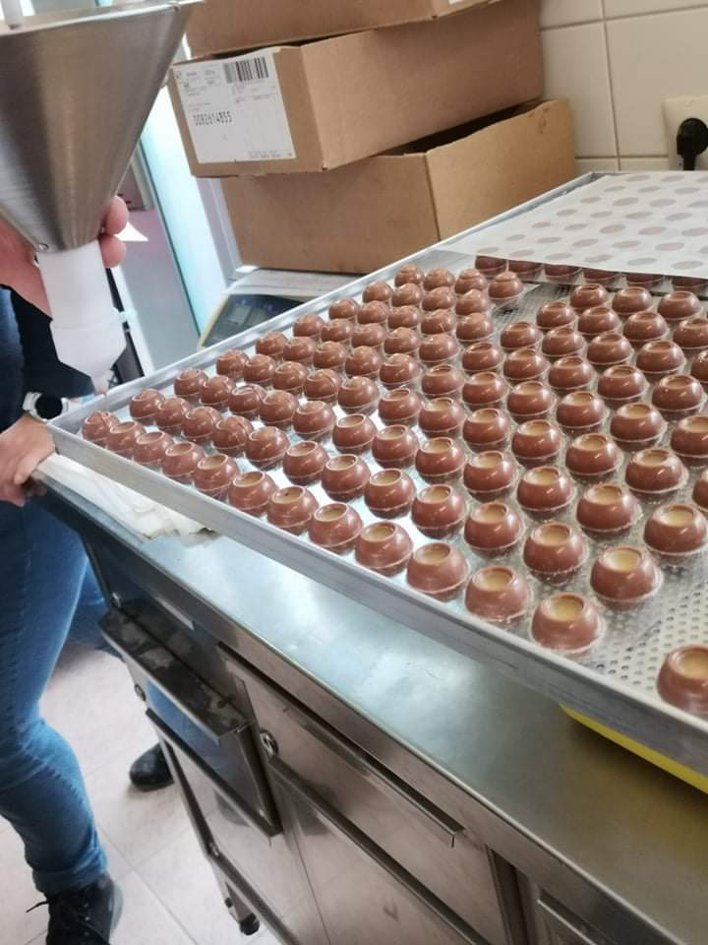
Tasks we needed to fulfill
Making bonbons casting
Making chocolate: White chocolate, Fruity, black chocolate
Making Biscuits

Slide 9
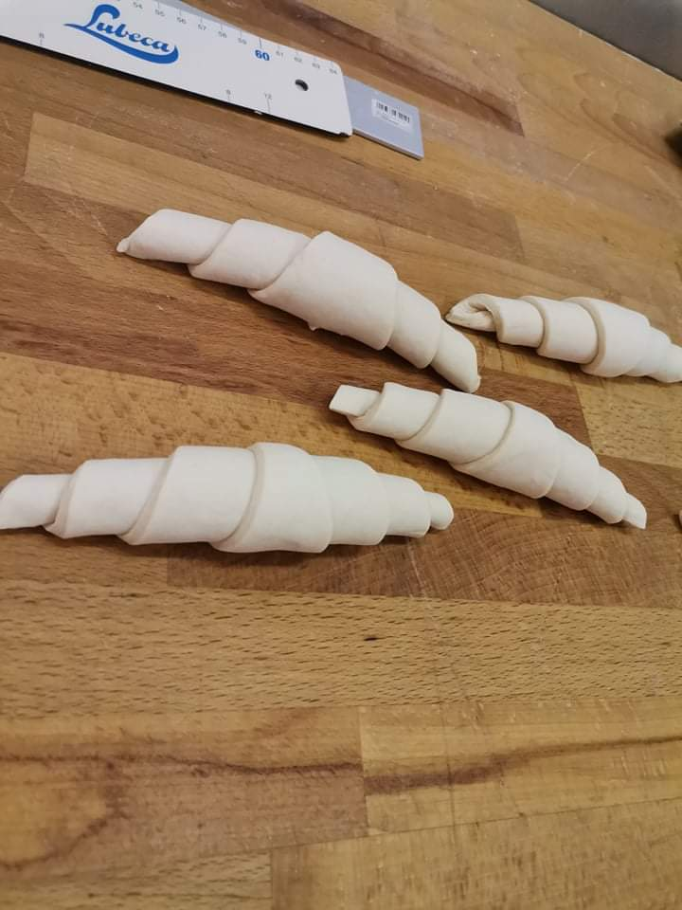
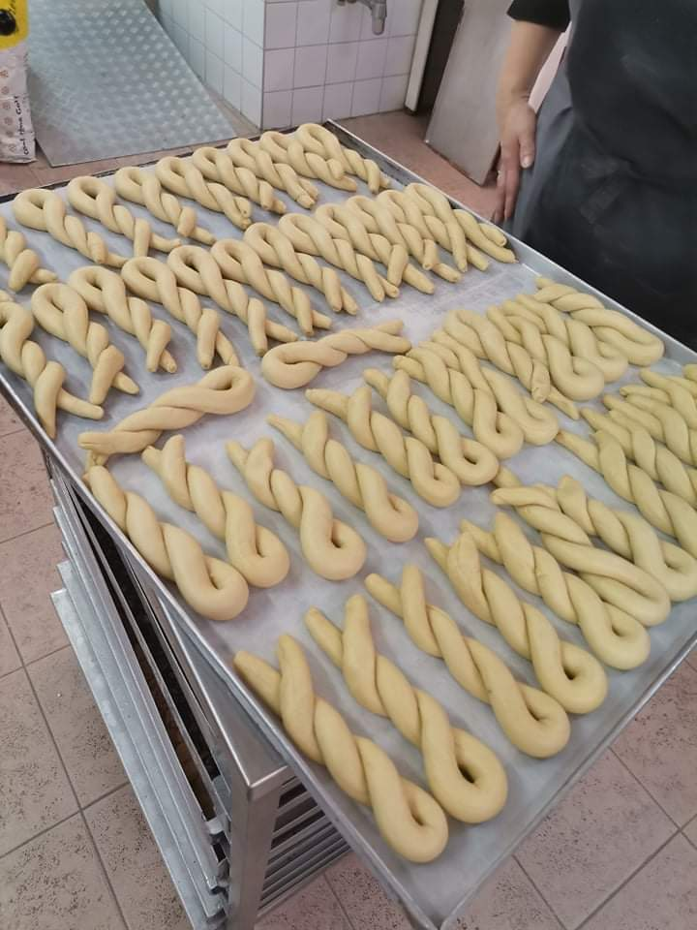
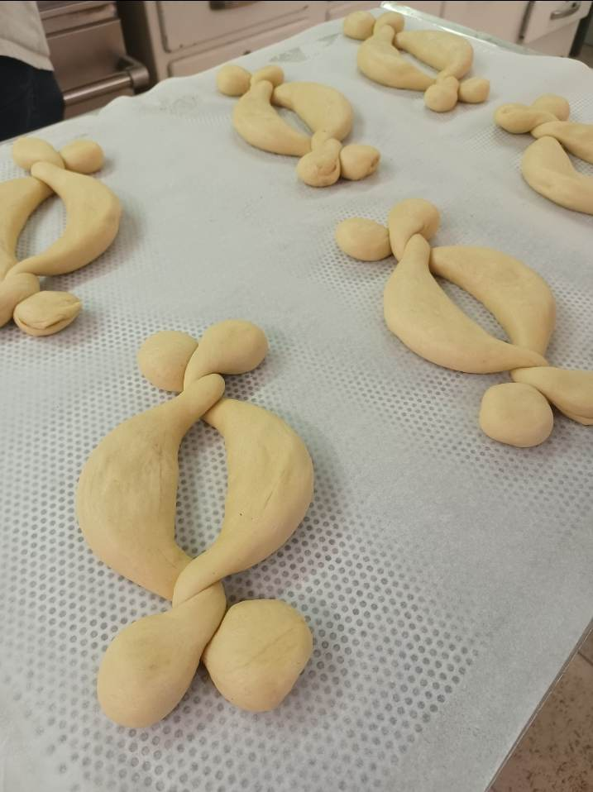
Things we did at our work
Measurement of raw materials (flour, milk, sugar, eggs, marzipan, yeast, etc.)
Dosing and weighing doughs (using scales, for different sizes, depending on what we use it for)

Slide 10
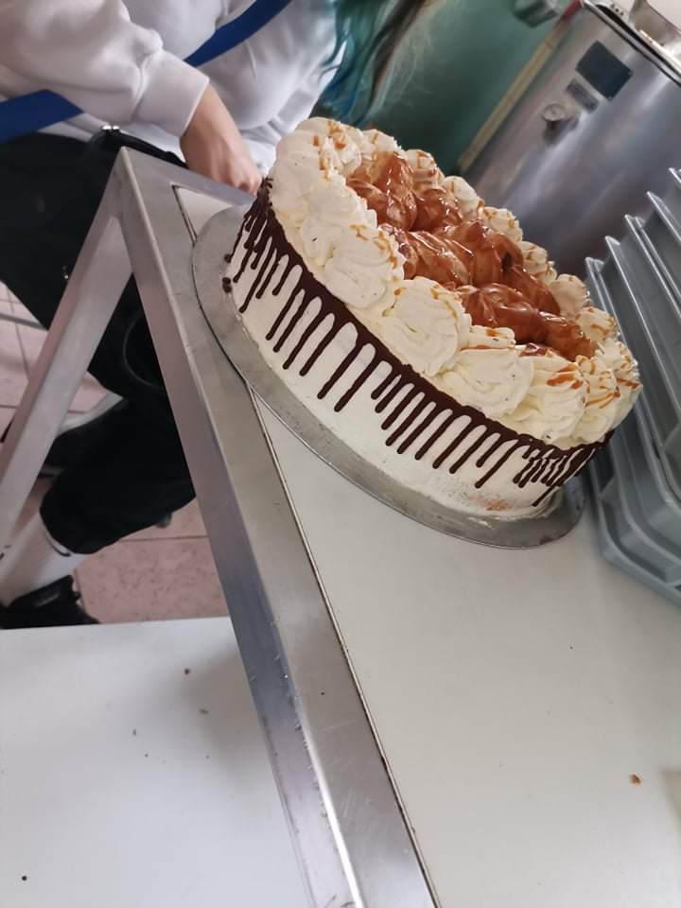
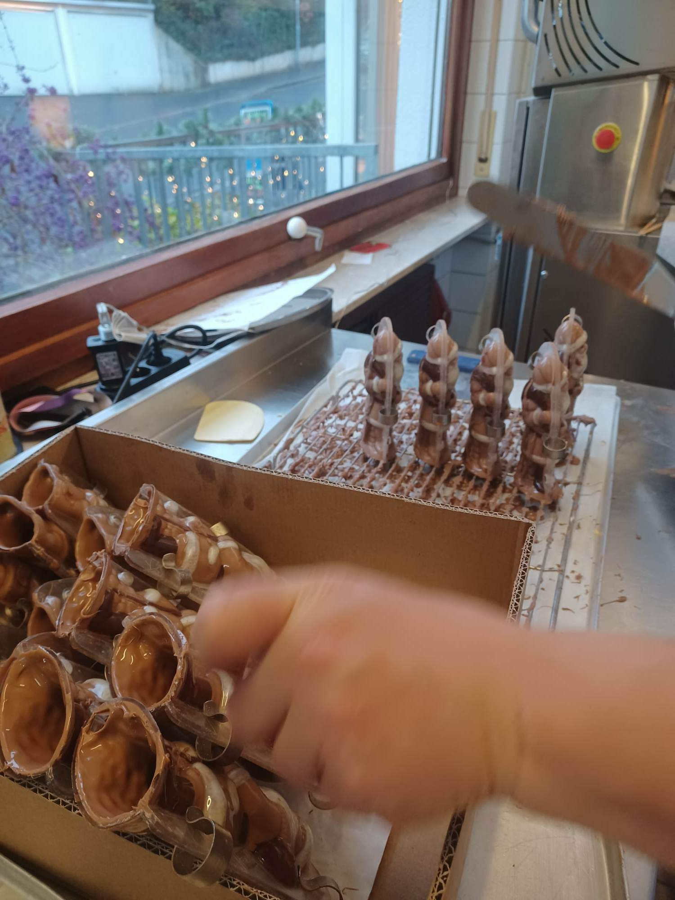
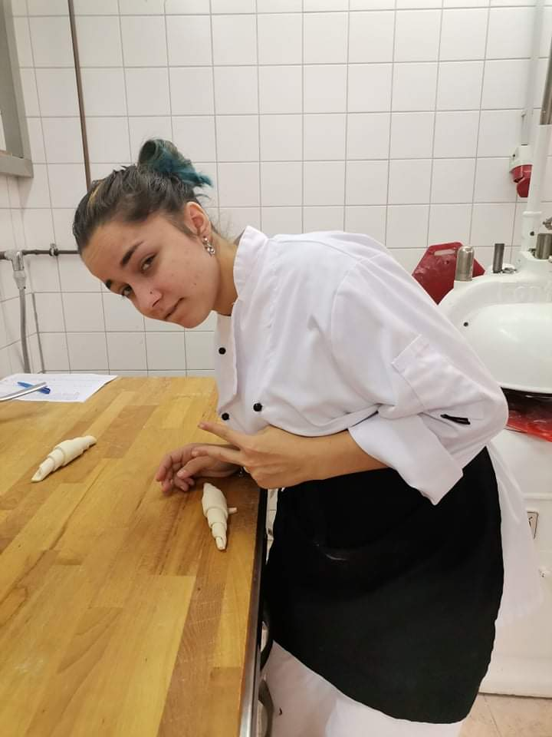
Daily tasks
Measuring, cutting and decorating of the cakes
Mastering how to make pastries
Putting products on the counter for customers to see
Product packaging for a first adven day

Slide 11
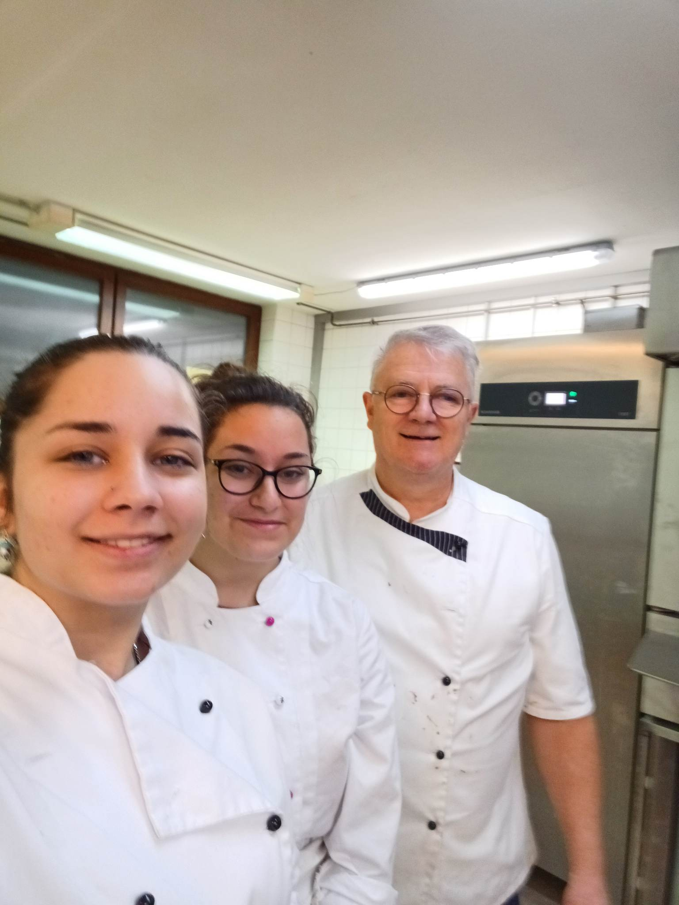
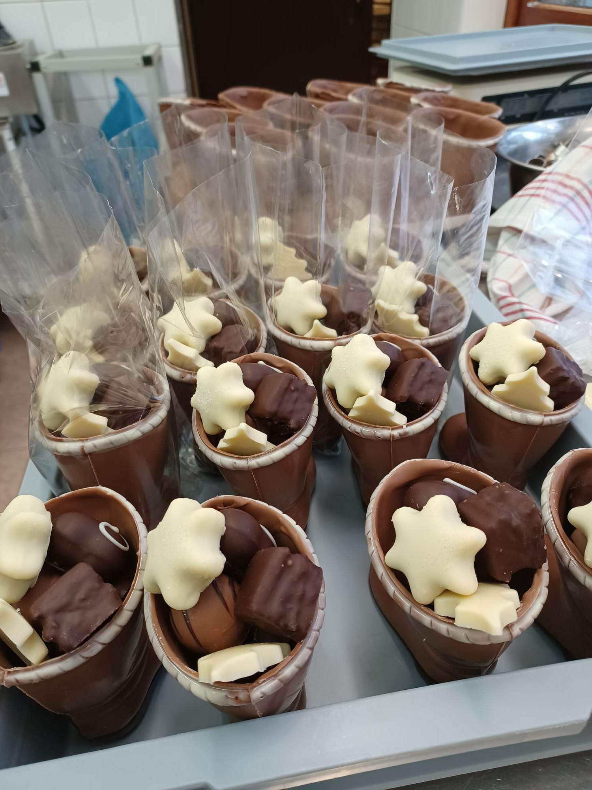
Products that we made
Christmas cakes
Bonbons
Ganache
Chocolate figurines
Making biscuits
Shaping breads
Pretzel

Slide 12
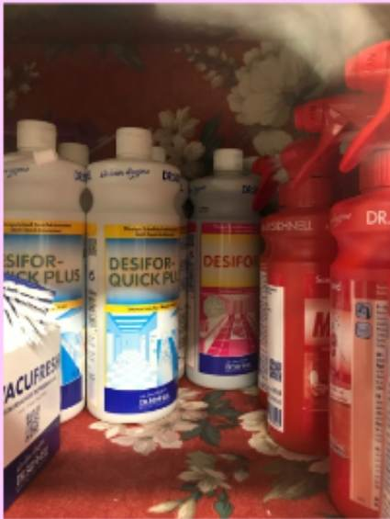
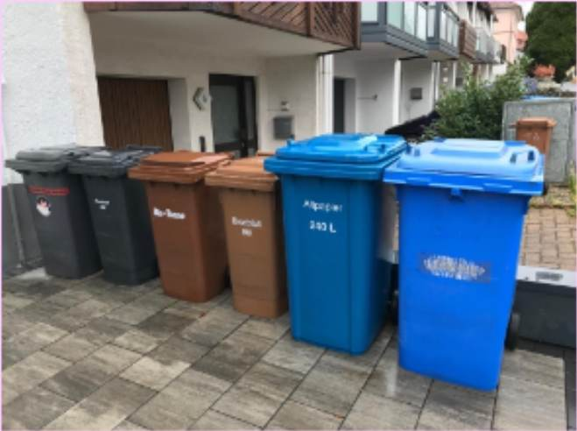
Haccp according to the preparation processes
Separate waste collection
Environmentally degradable packaging materials
Only using chemical-free cleaning products

Slide 13
Thanks for everyhing to:
The European Union
The Erasmus+ Food-Tour program
The Aschaffenburg School Centre
Vocational Training Center of Miskolc, István Szentpáli Technical and Vocational School of Catering and Trade
Confiserie Fischer
A projektet az Európai Unió támogatta. A kiadványban (közleményben) megjelentek nem szükségszerűen tükrözik az Európai Bizottság nézeteit.

