Slide 1
Erasmus+ VET Mobility, 2020-1-HU01-KA102-078492 FOOD-TOUR: Fostering Transferable Skills
Food-Tour VET STUDENTS’ MOBILITY / GERMANY
06. November 2022- 29. November 2022.
Placement: Hotel Wilder Mann, Aschaffenburg
Made by: Dora Zsarnai, Daniel Ilasik
A projektet az Európai Unió támogatta. A kiadványban (közleményben) megjelentek nem szükségszerűen tükrözik az Európai Bizottság nézeteit.

Slide 2
Partner School Connections: (Germany – Hungary)
Hungary: Vocational Traning Center of Miskolc, István Szentpáli Technical and Vocational School of Catering and Trade
Germany: Beruffschule III - Aschaffenburg

Slide 3
Partner School in Aschaffenburg: State Vocational School center Aschaffenburg
Our partner school in Aschaffenburg maintains good relations with other partner schools around the world. Our school is one of the oldest partners of theirs.

Slide 4
Courses in our partner school:
Receptionist
cook
butcher
confectioner
waiter

Slide 5
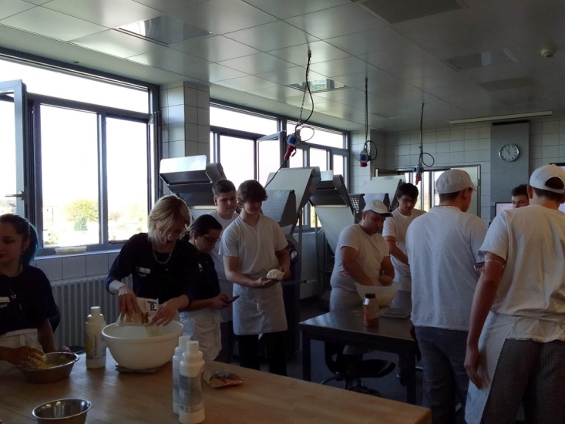
We took part in a pastry chef's practical class at the Beruffschule III.
We got to know the usage and the maintenence of several new utensils, machines. After that, we took part in practical pastry training, where we baked Linzer baskets together with the German students there.
We practiced group work into international mixed groups.

Slide 6
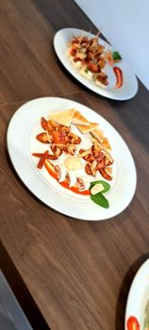
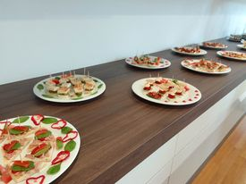
Visit to our partner school
We had the opportunity managers of our partner school to to host the teachers and taste Hungarian food.

Slide 7
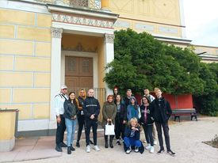
Sights to see in Aschaffenburg
Johannisburg: Located on the banks of the Main, the building was converted into a museum after the Second World War.
Pompejanum: It was built between 1842-1849 by King Louis I of Bavaria

Slide 8
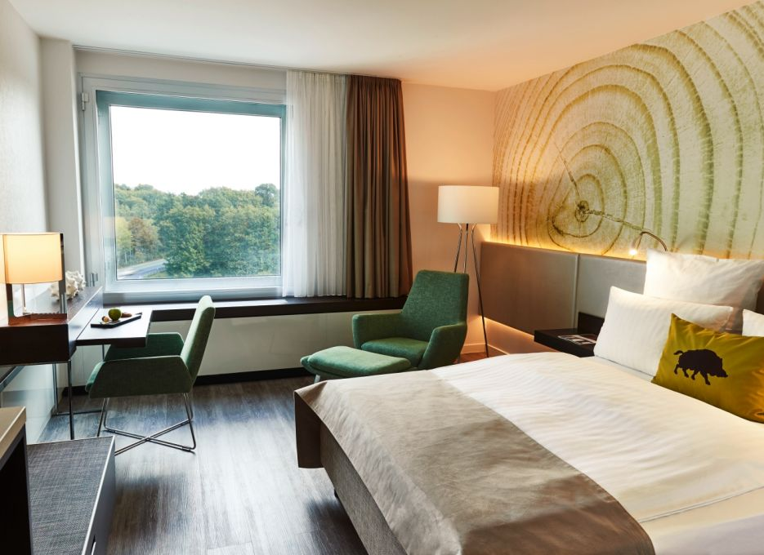
Steigenberger Airport Hotel visit in Frankfurt
544 rooms
20 luxury suites
TVs
wellness showers,
air conditioning,
safes,
minibars,
free WIFI,
fine dining,
fitness area

Slide 9
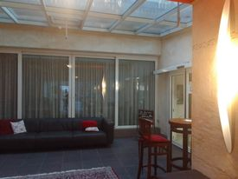
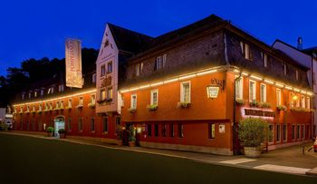
Our Placement: The Hotel Wilder Mann Wildermann

Slide 10
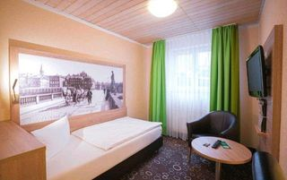
Accommodation:
Comfort single room
Comfort plus single room
Comfort two bed room
Comfort plus two bedded room
Apartment
Free-Wifi
Sauna, Various massages and treatments

Slide 11
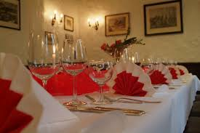
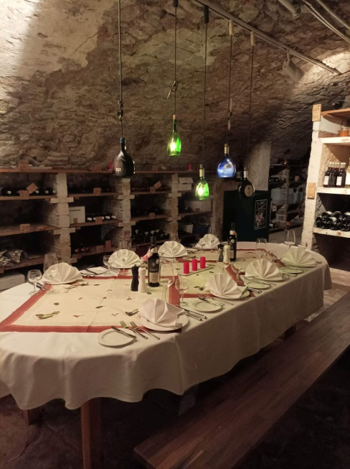
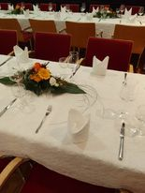
Events at the Hotel Wildermann
weddings
engagements
birthdays
name days
meetings
business dinners

Slide 12
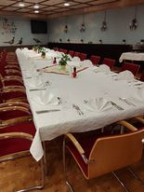
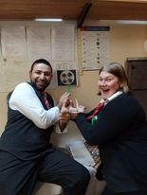
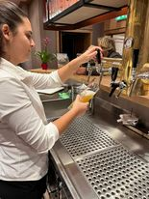
The work circle and colleagues
Dora- waitress
Job duties: breakfast, table setting, cleaning, cutlery cleaning, serving
Co-workers: Hussein, Jode, Julia, Amini

Slide 13
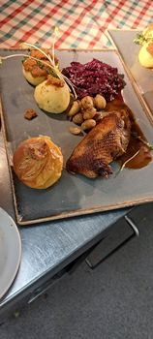
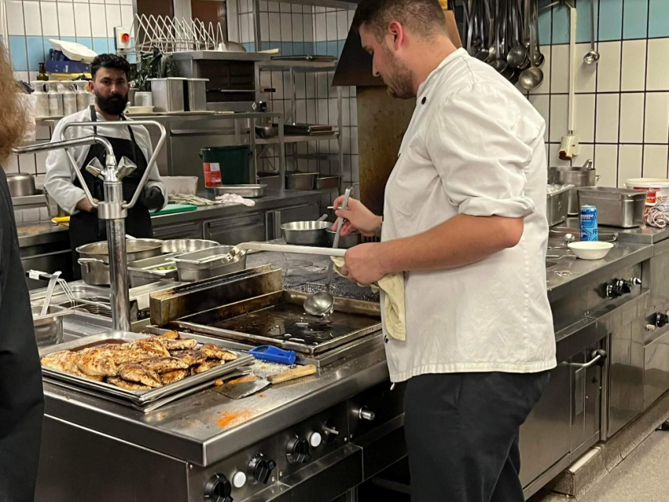
The work circle and colleagues
Dani - cook
Job duties: prepare, cooking, serving, baking
Co-workers: Peter, Daniel, Dennis, Ramazan,
Zákária

Slide 14
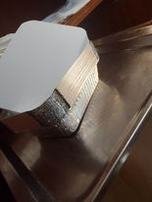
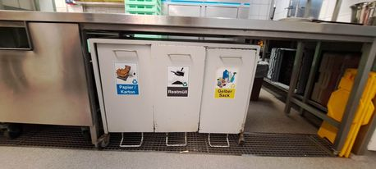
Selective waste collection and recycling
They pay a lot of attention to selective waste collection here
Food is placed in reusable packaging

Slide 15
My experiences while I was here
They pay more attention to hygiene both in the guest room and in the kitchen.
We could learn many important things from them

Slide 16
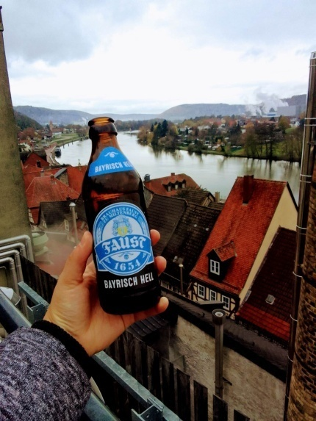
Breuhause Faust
Brewery located in the old town of Miltenberg. It was founded in 1654.
Beer specialties: Light and dark wheat beer, alcohol-free
Craft beers: Barley wine, barrel-aged Eisbock, vintage strong beer

Slide 17
Christmas market in Aschaffenburg It is held every year in front of Johanniburg Castle

Slide 18
Thank you for the
Partner school: Berufsschule III- Aschaffenburg
Vocational Training Center of Miskolc, István Szentpáli Technical and Vocational School of Catering and Trade
The management of The Hotel Wildermann
The school management, the international coordinator and the accompanying
our teachers and tutors
A projektet az Európai Unió támogatta. A kiadványban (közleményben) megjelentek nem szükségszerűen tükrözik az Európai Bizottság nézeteit.
Notes:
Z

