Slide 1
MISKOLCI SZAKKÉPZÉSI CENTRUM
ERASMUS+
2024-1-HU01-KA121-WET-000211394
With the Students of the Miskolci SZC Szentpáli István Kereskedelmi és Vendéglátó Technikum és Szakképző Iskola Student Mobility Ireland
Created by: András Kondor and Liliána, Diána Tóth
Class: 1/13V and KSZ11/E
Date: 15.04.2025

Slide 2
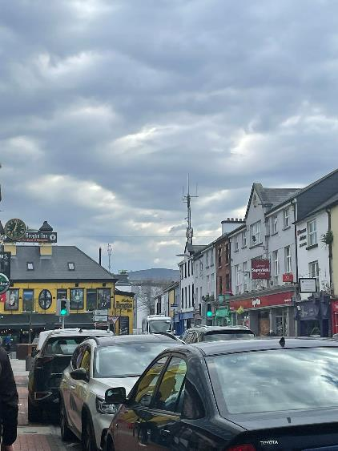
VISITING TRALEE IN IRELAND
Located in South-Western Ireland
Tralee is the county town of County Kerry since the 13th century in the south-west of Ireland.
Picturesque town with chorches and abbeys and ruins of castles

Slide 3
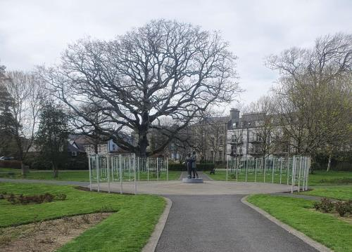
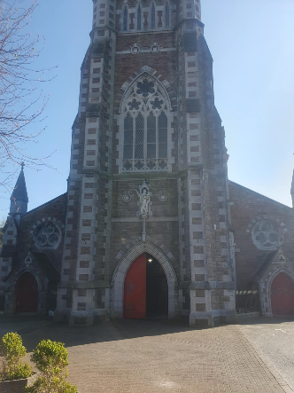
BEST THINGS TO DO IN TRALEE
Tralee castle
Kerry County Museum
Siamsa Tire, National Folk Theatre & Arts Centre
Tralee Town park
Wind mill

Slide 4
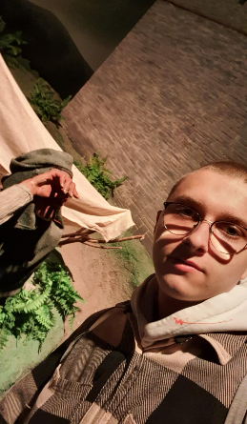
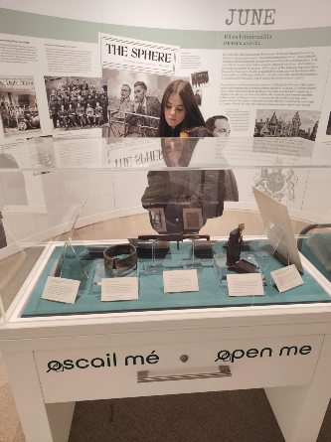
KERRY COUNTY MUSEUM
Kerry County Museum: developed as an initiative of Tralee Urban District Council in two phases between 1991 and 1992.
In 1992 the main gallery of the Museum was opened, displaying the archaeology and history of the county.
It collects, records, preserves, displays, and communicates material relating to the archaeological, historical and cultural heritage of County Kerry.

Slide 5
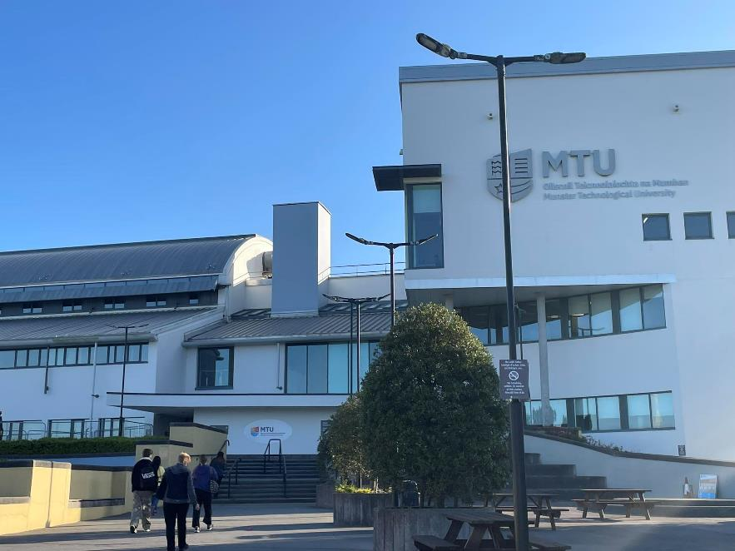
PARTNER SCHOOL OF MSZC SZENTPÁLI IN TRALEE
Munster Technological University (MTU)
Flexibel, learning, oppurtunities
School of sience and technology
Two post graduate programs
Research oppurtunities
High quality teaching and learning environment
Full time undergraduate courses
International recognized qualification

Slide 6
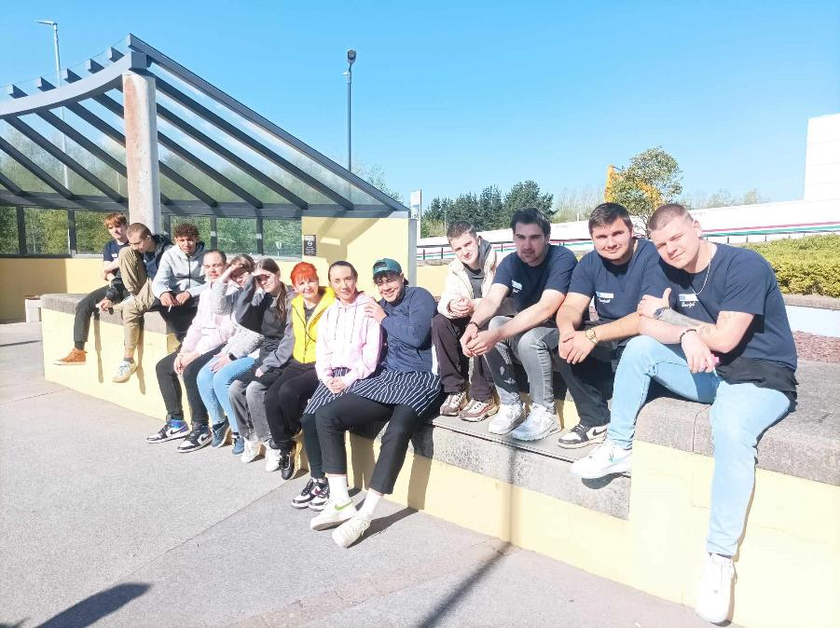
SCHOOL OF BUSINESS, COMPUTING AND HUMANITIES
Head of school: Ms Mary Rose Stafford
Head of Department: TJ O’Connor
Culinary arts and turisum
Curses: Bachelor of arts (honours) in trevel and tourism managment (4 years)
Higher certicate in arts in hospitality studies (2 years)
Higher certificate in culinary arts (2 years )
Bachelor of arts in culinary arts (3 years)
Bachelor of arts and turisum managment (3 years)

Slide 7
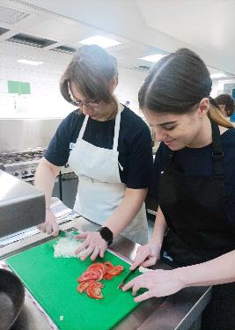
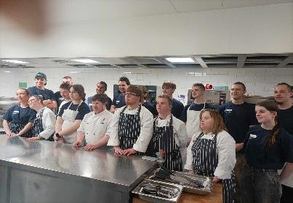
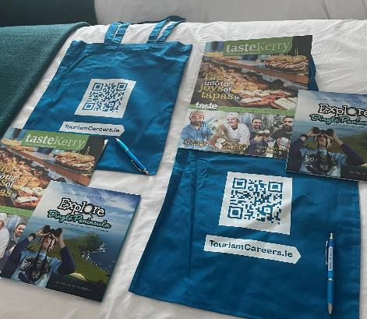
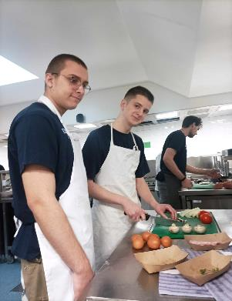
WHAT HAVE WE DONE IN MTU TRALEE
Cooking together with a group of people with Down syndrome as part of chefs Mark Murphy and chef TJ O'Connor's experiment.
Joint lunch with our Irish special friends
Lecture about the opportunities that might be available to us, talked about positions that can be filled at the university, and the competencies we need for these roles.
They thanked us for our day, and we received gifts: a book, a newspaper article, a bag, and a pen.

Slide 8
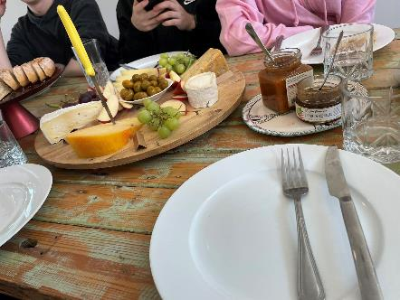
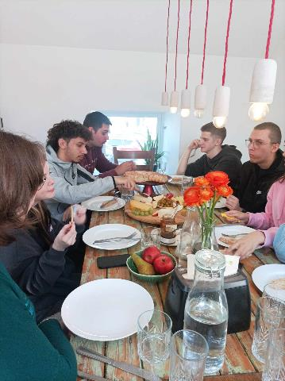
Cheese demonstration and tasting Little cheese shop
We arrived at the cheese-tasting shop, then went upstairs where we were greeted by a large tray of cheeses and fruits, accompanied by small breads and water.
We were introduced the production of local cheeses
We were able to taste the following cheeses with the group: Coleeney Brie, Goat Log Tipperary, Slob Cow Cork, Sinan Cow Galway, and Kell’s Bay with Seaweed

Slide 9
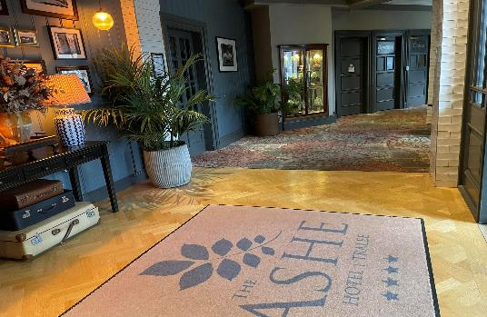
MY PLACE OF WORK: THE ASHE HOTEL
Maine St, Tralee, Co. Kerry, V92 W56F, Ireland
The Ashe Hotel is something special. A personal and friendly neighbourhood spot for those seeking their next adventure. Essentially, a casual blend of the eclectic and contemporary
Here guests can do nothing, but eat well, relax with a drink.

Slide 10
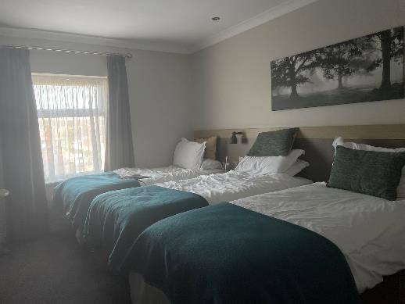
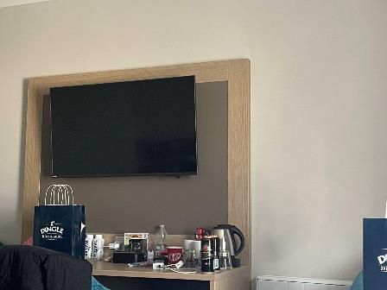
THE HOTEL ROOM
Our Triple Room
With three super-comfy single beds in our triple rooms, I and my Erasmus friends enjoy comfort and sleep. Light filled interiors, recently refurbished to a brilliant standard is amazing for us. We have everything here what we can think of.
Facilities: Bath with Shower, Direct Dial Telephone, Hairdryer, Internet Access, Iron and Ironing Board, Night Safe, Tea / Coffee Facilities, Television, Toiletries, Work Station

Slide 11
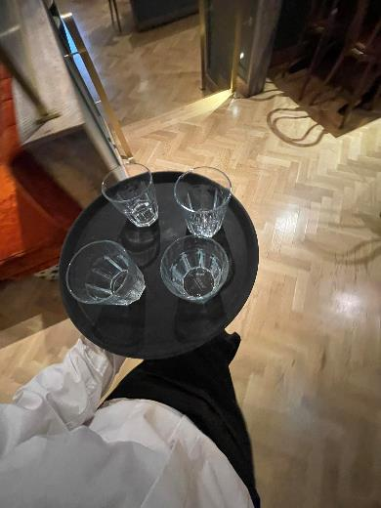
THE ASHE HOTEL RESTAURANT ALFIE’S LOUNGE
We had our breakfast here☺
Open daily: Brunch: 9am-11.45am, Lunch: 12pm-5pm, Dinner: 5pm-9pm
Alfie’s Lounge offers a variety of indoor and outdoor casual dining spaces, showcasing a European, mid-Atlantic inspired menu throughout the day.
With your educated palette in mind, eating at Alfie’s has been designed around fresh ingredients and good taste.
Cocktails range from seasonal specialities to updated classics.

Slide 12
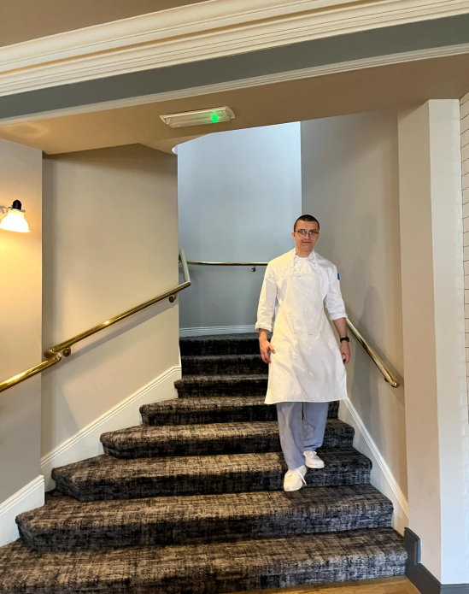
MY TASKS AS A CHEF IN THE ASHE HOTEL (ANDRÁS)
Vegetable chopping
Preparing breakfast
Making salsa
Julienne carrot cutting
Packing pastries
Washing and drying lettuce
Frying potatoes
Pureeing tomatoes and portioning into containers
Cutting lemons
Cleaning up after myself
Portioning sauces into containers
Plating meals
Using the computer in ordering ingredients.

Slide 13
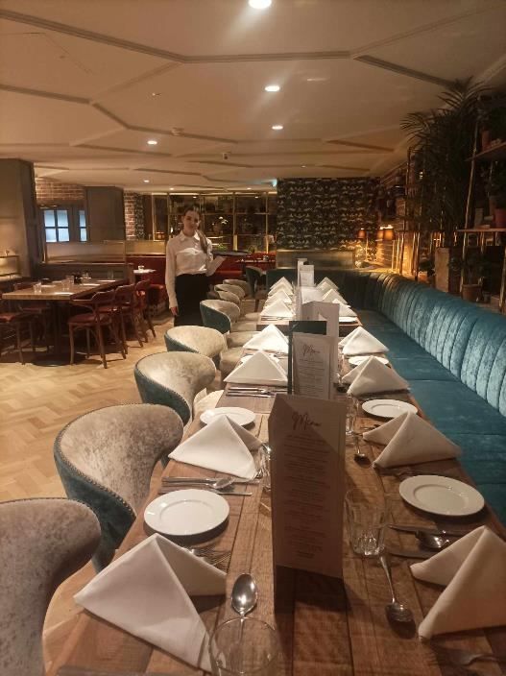
MY TASKS AS A WAITRESS IN THE ASHE HOTEL (LILIÁNA)
Breakfast service
Clearing tables
Setting tables (for breakfast, lunch)
Delivering menu cards
Serving guests (serving drinks, food)
Cleaning (brushing, mopping)
Replenishing the ice tray
Taking drink orders
Billing / payment processing
Using computer when taking orders and making payments.

Slide 14
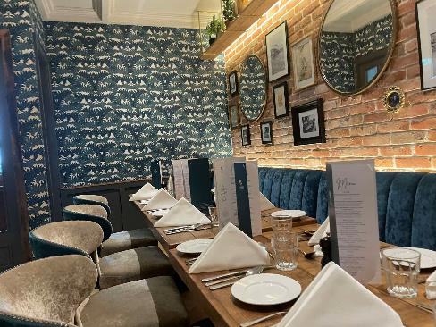
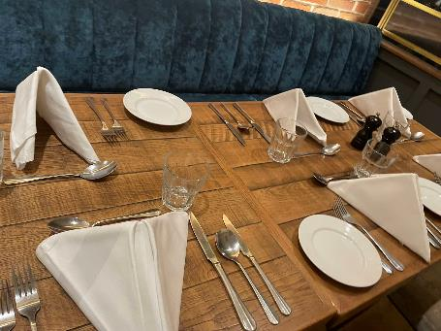
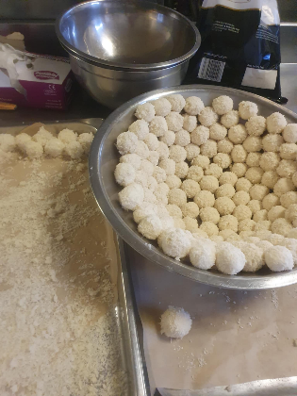
EVENTS I TOOK PART
Conference lunch:
Guests could choose their meals from a menu card
In separate section of the restaurant
My tasks (Liliána) :
I prepared the tables, then set them
Took the drink orders
Served the food
Handed out the dessert menu
Cleared the empty plates
My tasks (András):
Prepeared for lunch
Plated meals
Made the desserts

Slide 15
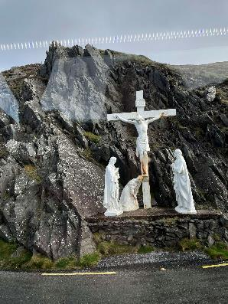
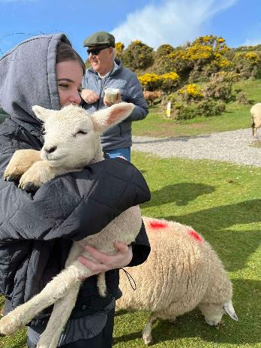
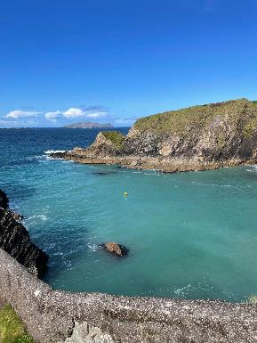
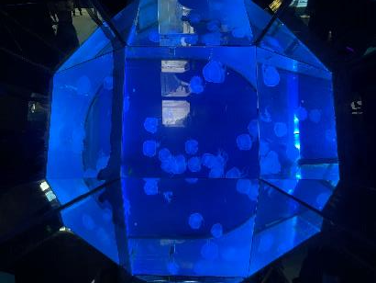
OUR JOURNEY IN DINGLE
Drive on the Wild Atlantic Way
Dunquin Pier, Connor path, Inch beach visit
Dingle Distillery guided tour
Aquarium visit
Lunch at the Boatyard Restasurant

Slide 16
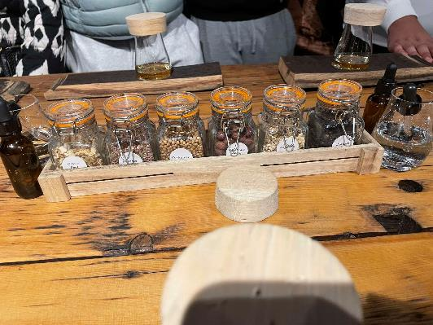
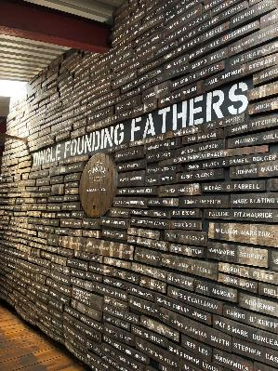
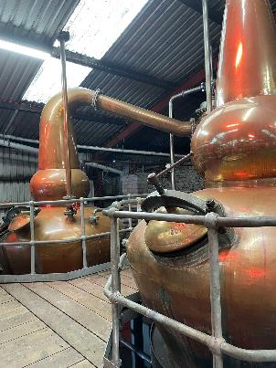
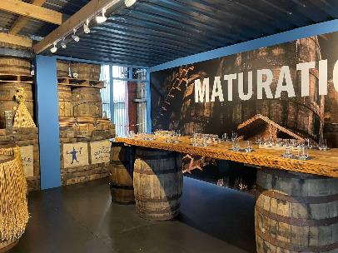
DINGLE DISTILERRY GUIDED TOUR
Original name: Dingle Whiskey Distillery
World famous whiskey, gin and vodka production
Well equipped, high quality machinery
Special casks for storing

Slide 17
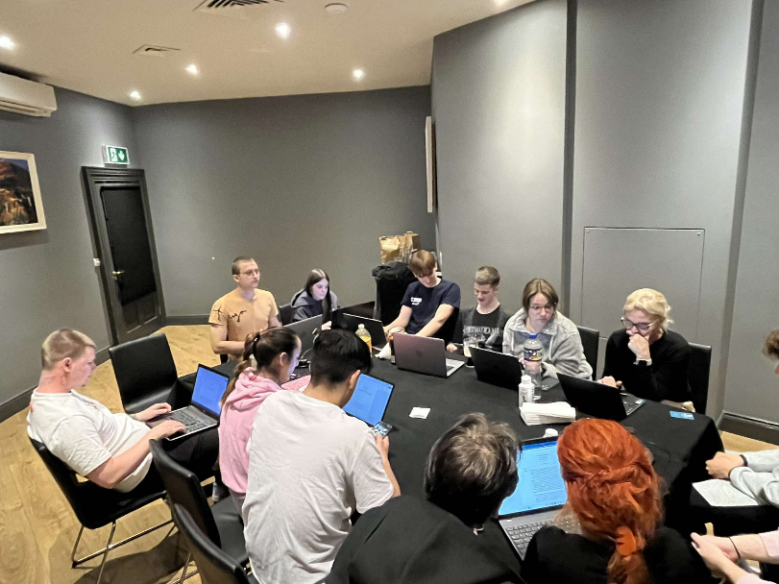
SUMMARY
We learnt a lot in the Erasmus mobility:
I am more motivated, better organised, can work aloner and in a group
I am more open minded and better understanding
Our English knowledge developed
We improved our intercultural knowledge
We got to know the essence of vocational dual system better
Lili got better in servicing skills, András got better in food producing

Slide 18
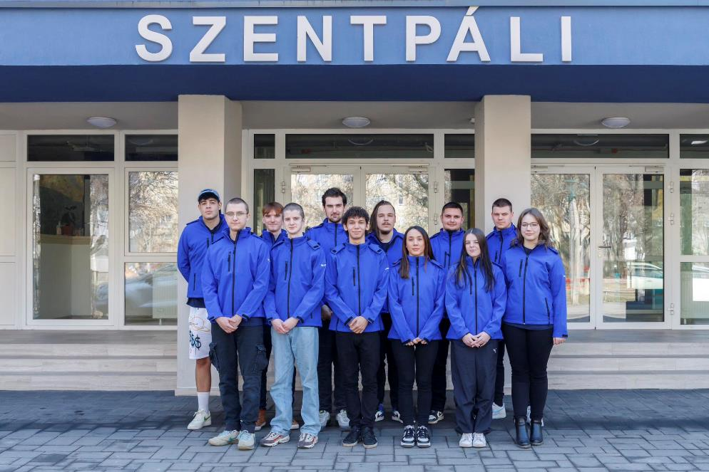
THANK YOU FOR WATCHING OUR ERASMUS+ EXPERIENCE IN TRALEE

